Slide 1

Portable User Interface For Cyber Security Awareness
By: Nicholas Jones

Slide 2
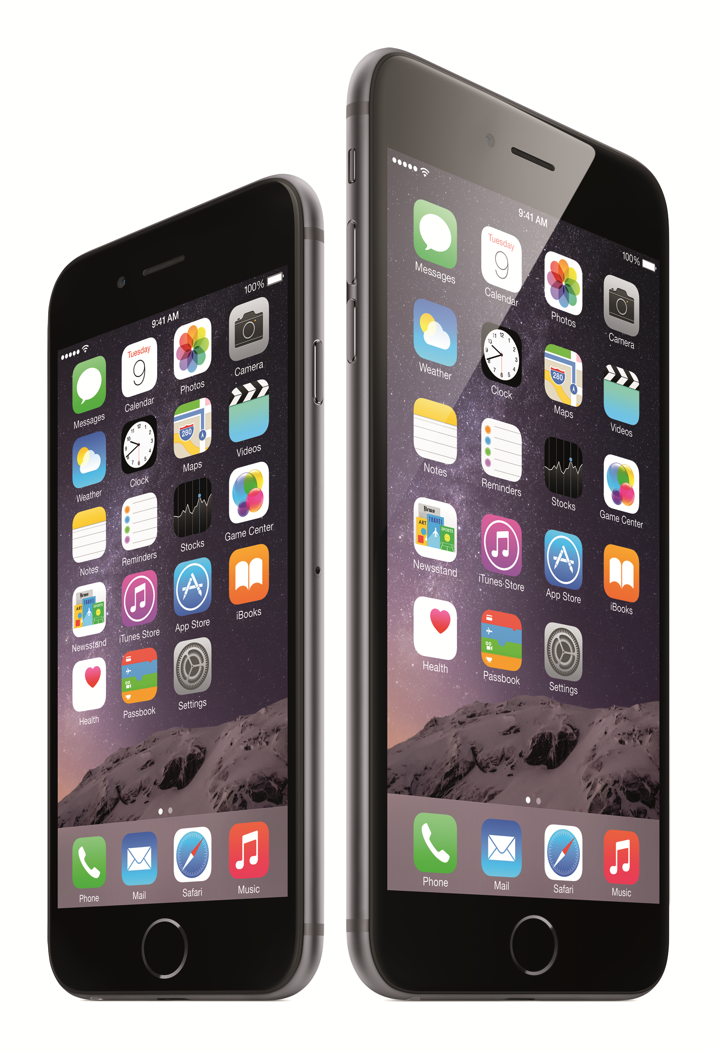
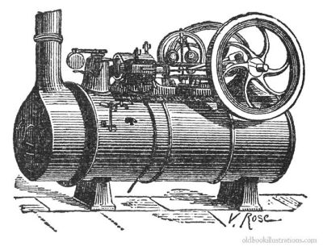

Most creations Arise from problem solving
iPhone
Steam Engine
Wheel

Slide 3
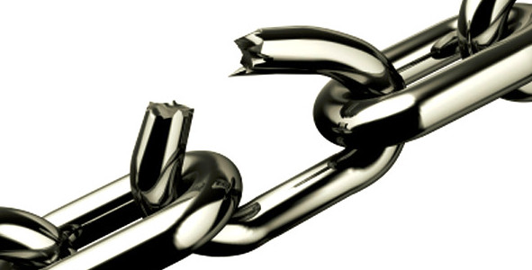
What’s my problem?
The weakest link in Cyber Security as a whole..

Slide 4
Human Error

Slide 5

Today’s Topics
The Problem at Hand
Researching the Problem
Project Overview
Hardware/Software
Process
Application of Project/Outlook

Slide 6
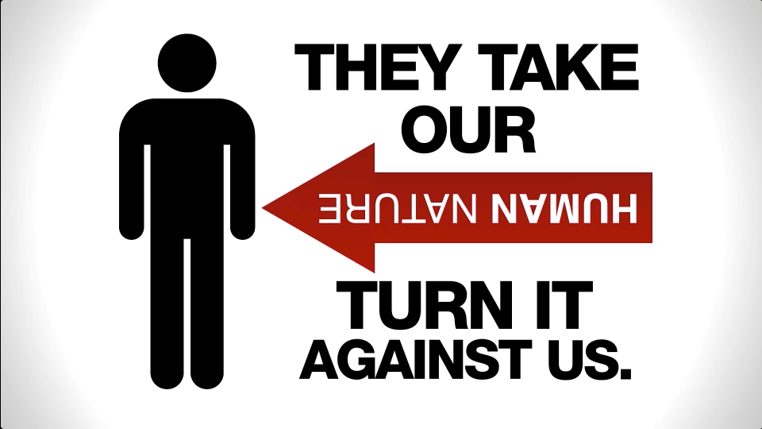
Back to the problem
Human error in the general public is imminent with cyber security.
Social Engineering’s high success rate with people in general.
People are simply just uneducated about cyber security.

Slide 7
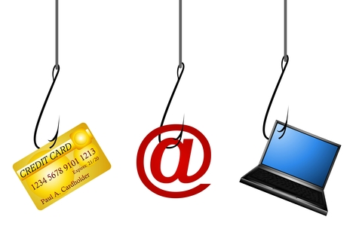
What makes this dangerous?
The everyday person is aware of hackers and scams.
Need to understand these scams and phishing schemes on a more technical level.
In both the private & government sectors, everyday people are the exploit that hackers prefer.

Slide 8


Examples
Syrian Electronic Army’s attack on the Associated Press’ Twitter.
Simple email spear-phishing attack.
Human Error could be avoided within victim.
Teenager’s simple attack gaining access to CIA director’s email.
Simple phone call social engineering.
Human Error could be avoided within resources surrounding victim.

Slide 9

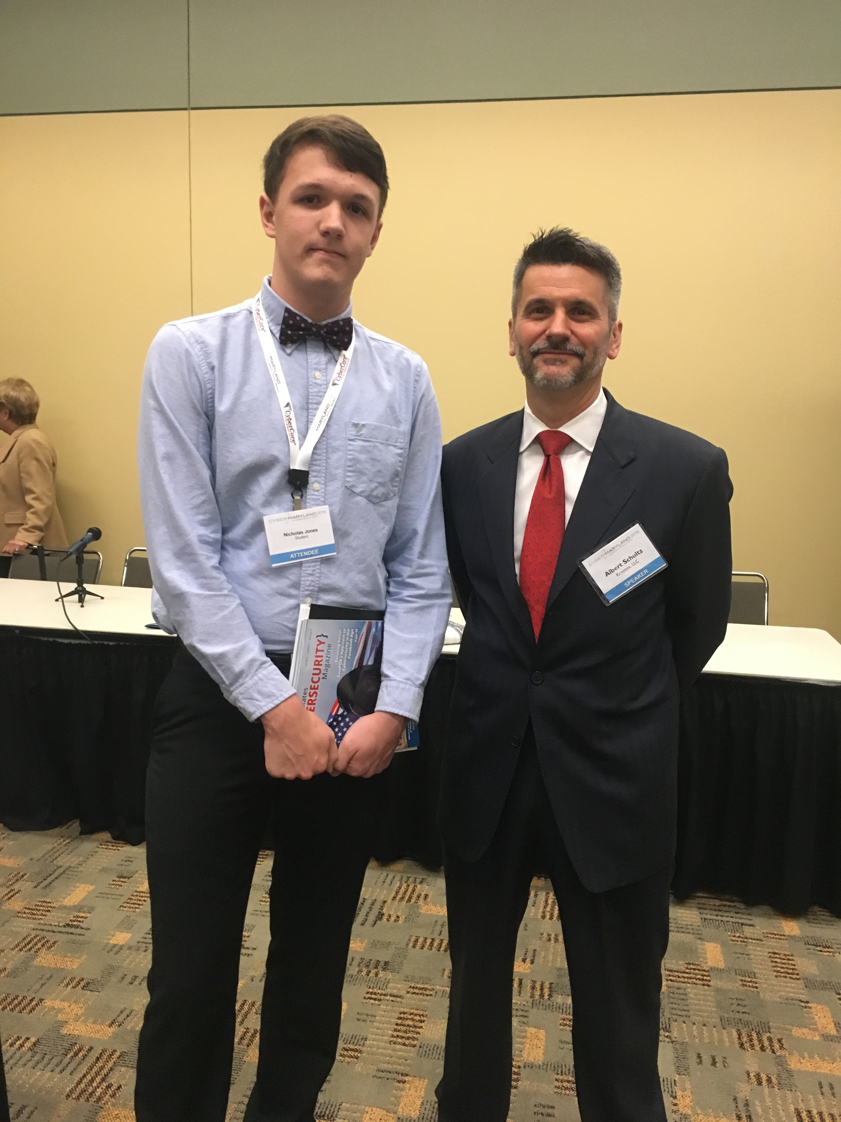
Cyber Maryland Conference 2015
I attended the 2015 Cyber Maryland Conference in Baltimore, MD
Educational Workshops
Lots of Private/Government Sector Companies
One particular presentation caught my attention and was very interesting, as I was working on this project.
Albert Schultz, CEO of Krypteia , LLC presented on “The Human Element”

Slide 10
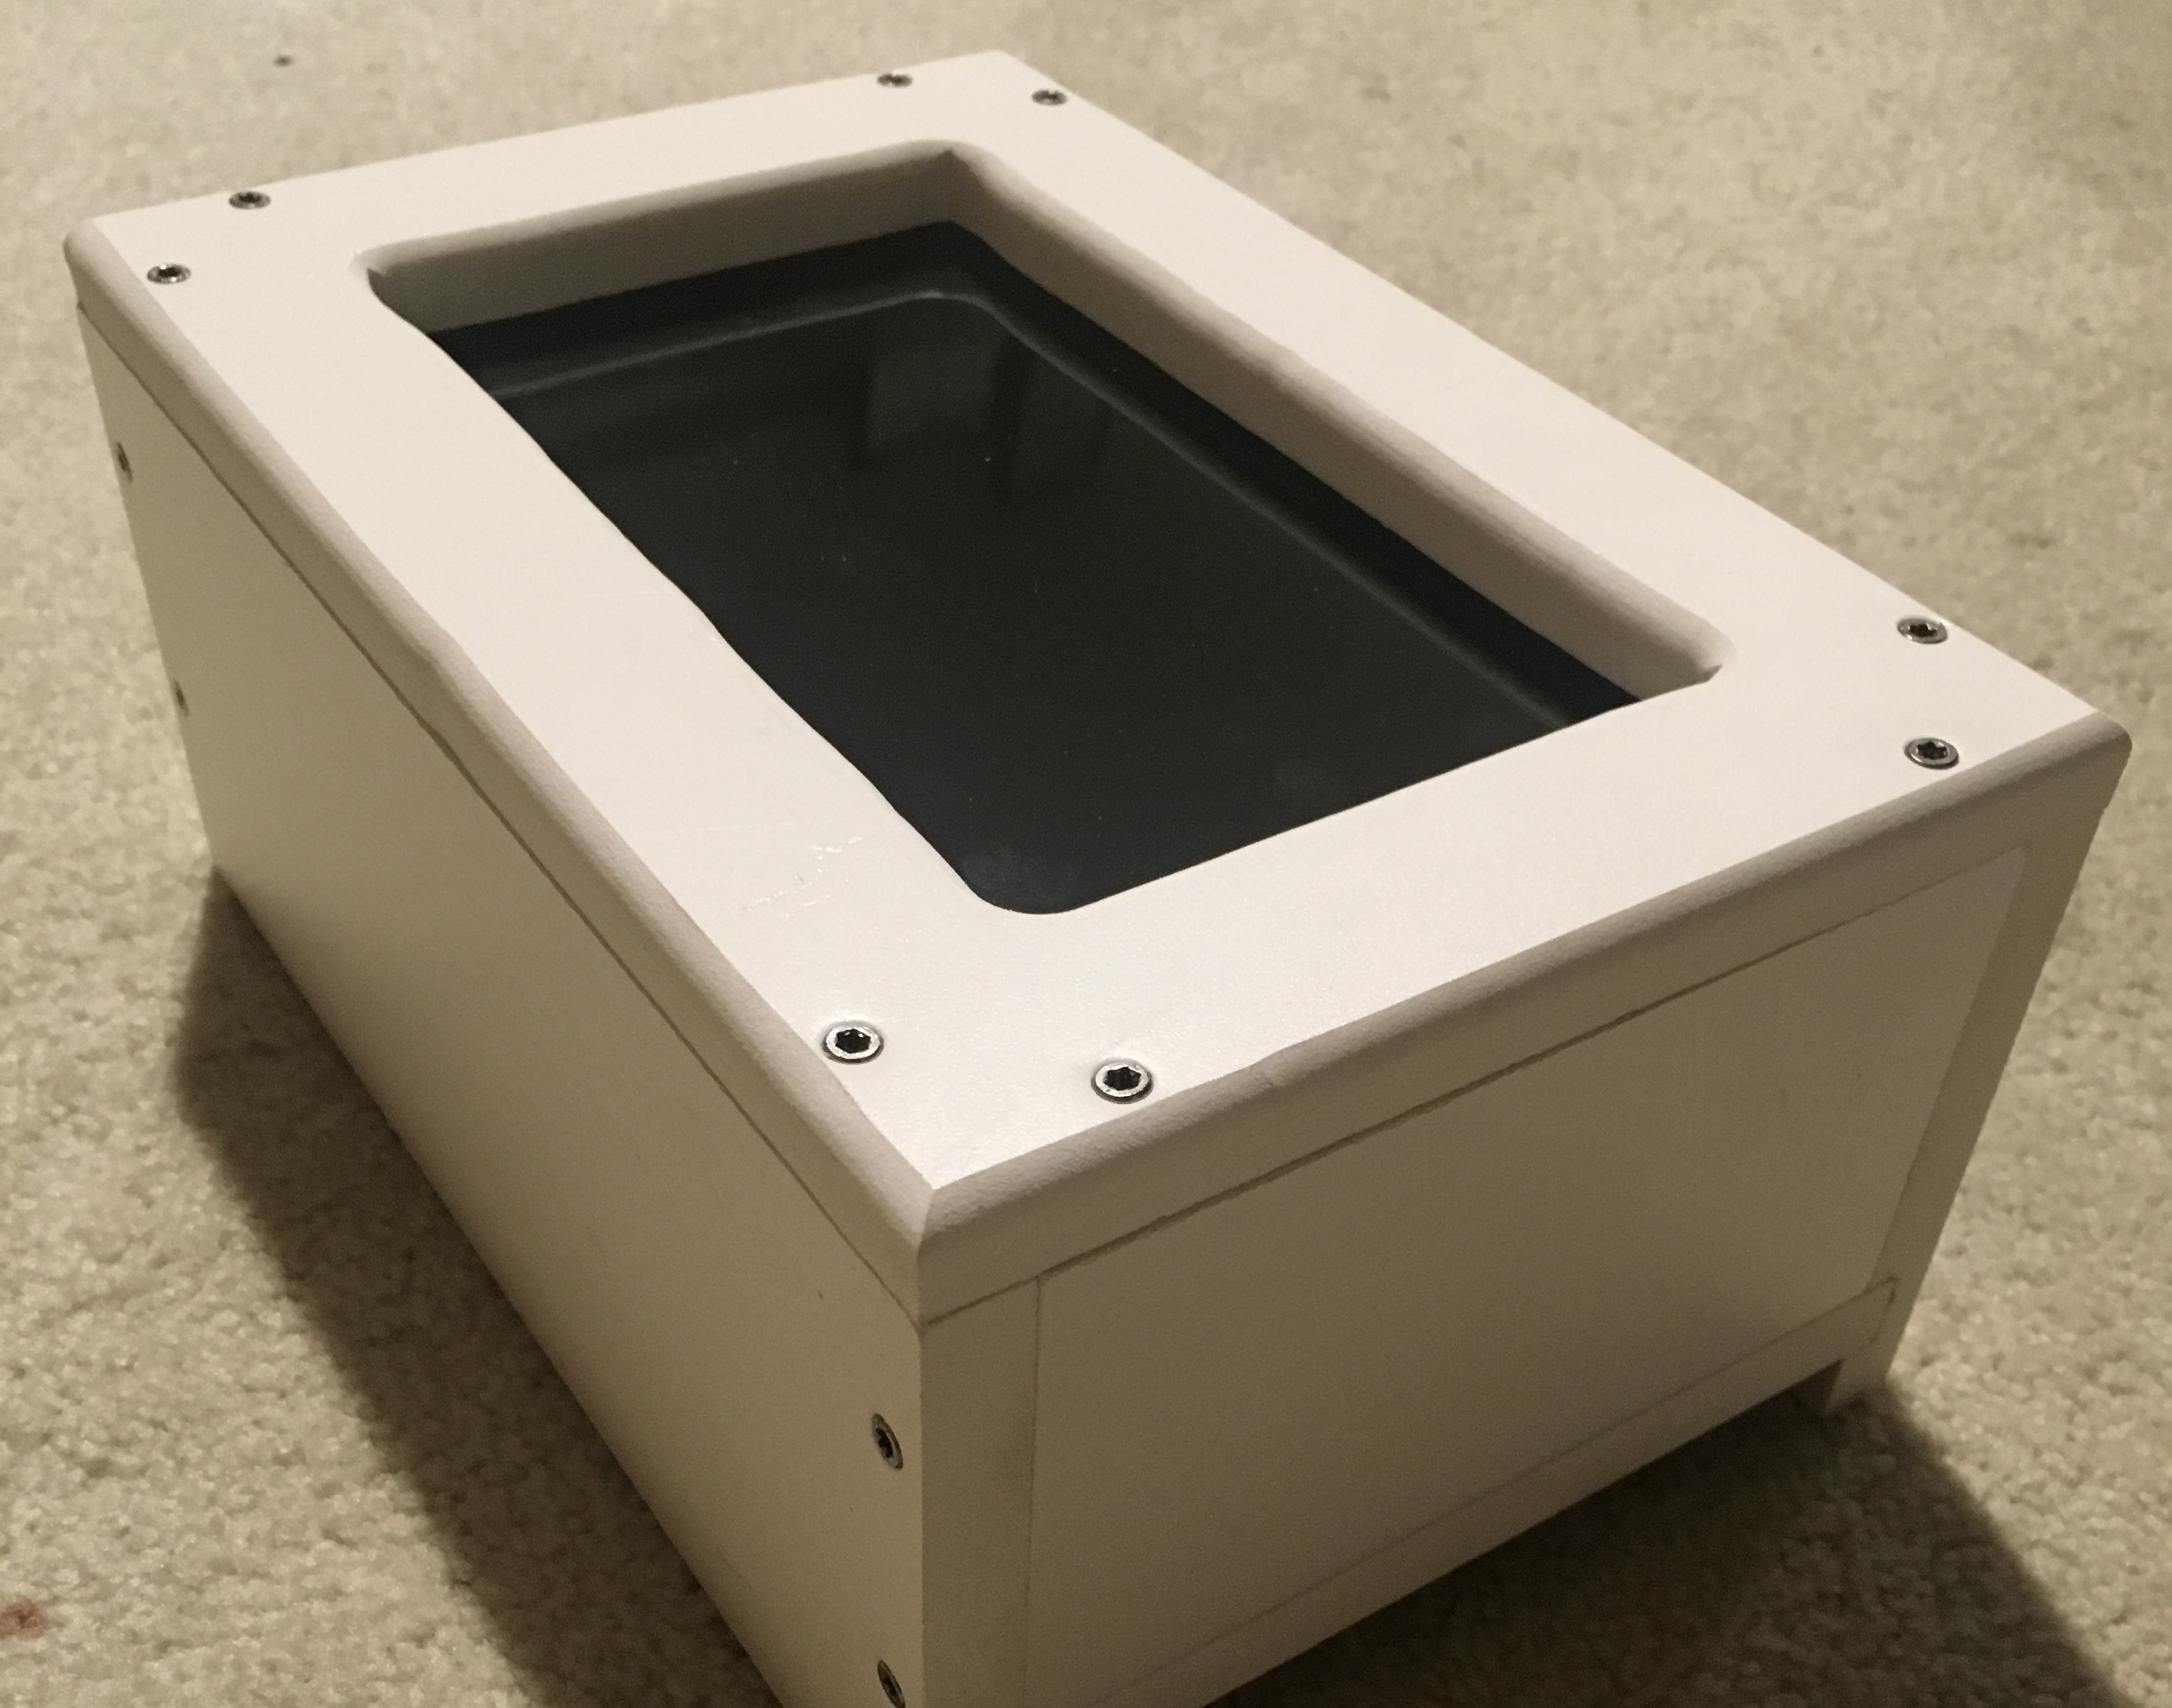
Project overview
Wanted to create something that exemplified my skillset, as well as something that would serve as an example for solving the problem researched.
The idea came out of my passion for working with Raspberry Pi’s, Servers, & Designing Websites.
Resulted in: Portable User Interface for Cyber Security Awareness

Slide 11
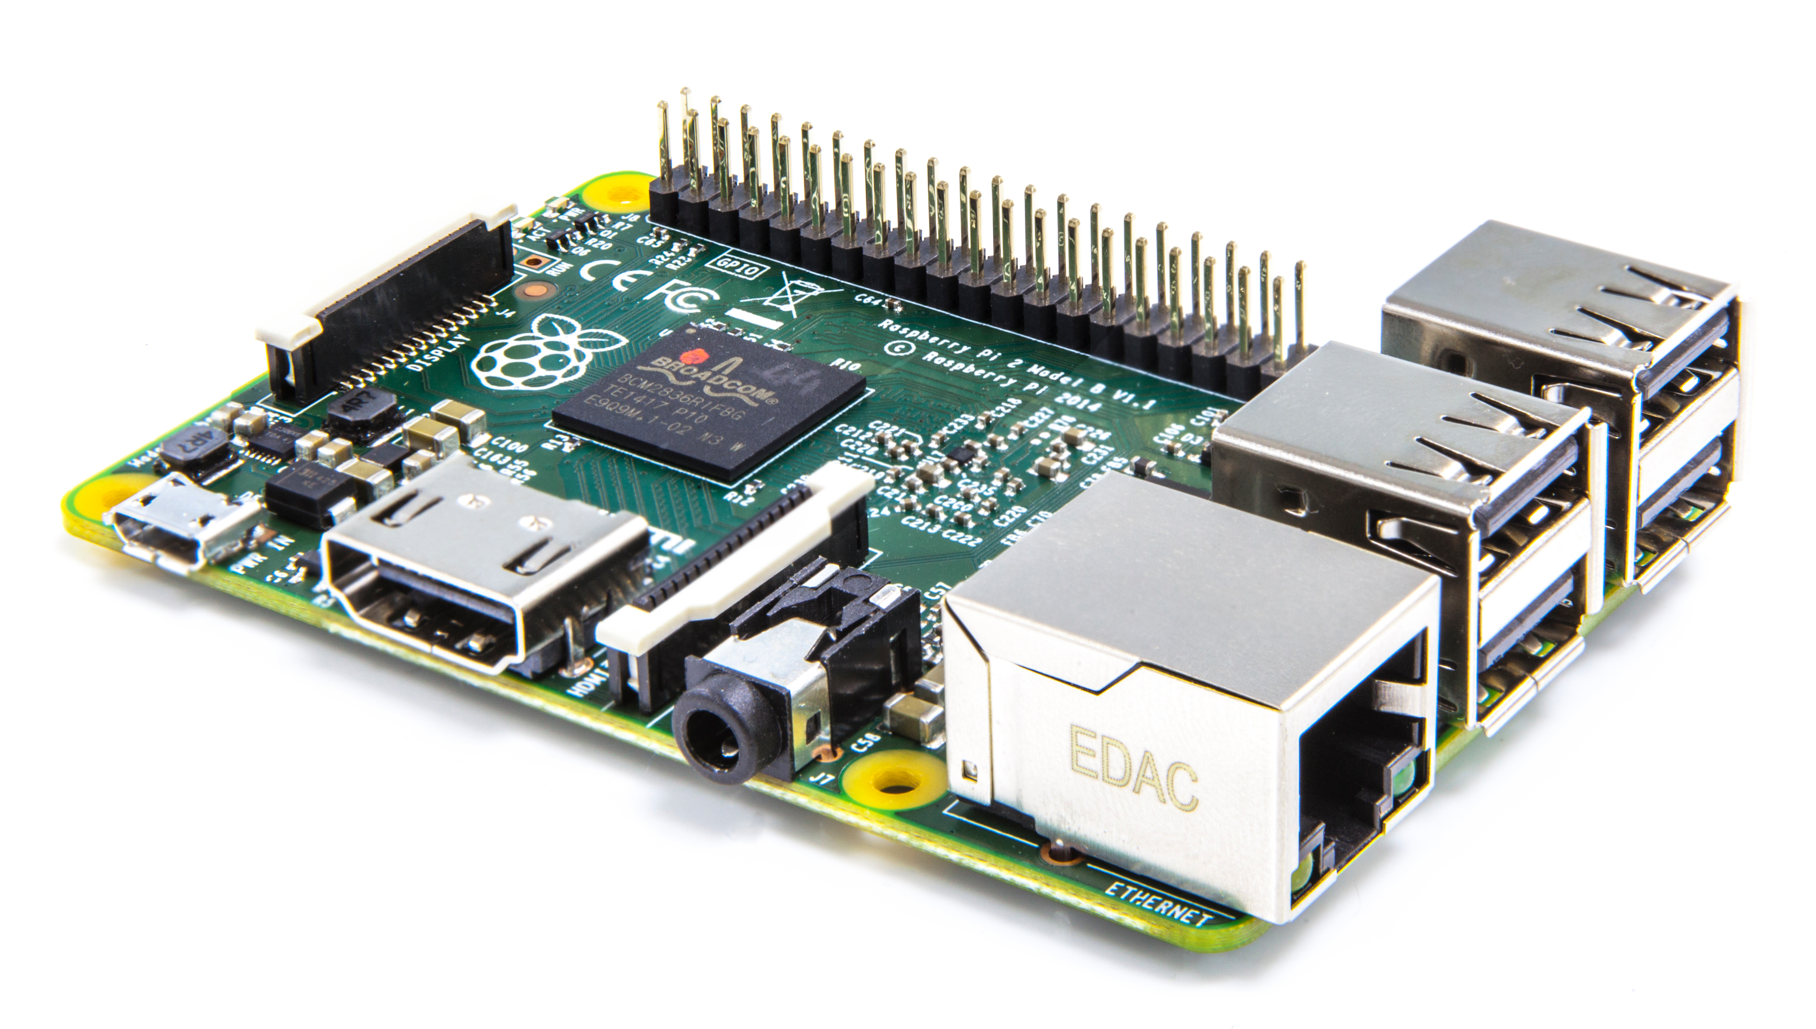
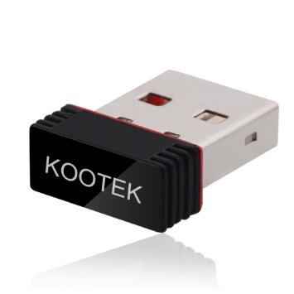
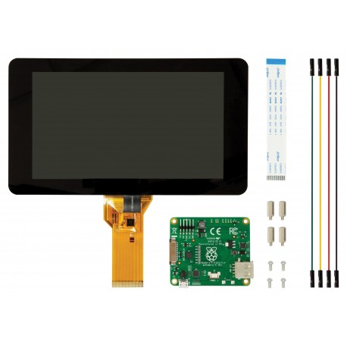
Computing hardware
Assorted USB Cables
USB WiFi Dongle
10,000 mAh Lithium Ion Battery
Raspberry Pi 2 Model B
A 900MHz quad-core ARM Cortex-A7 CPU
1GB RAM
8GB MiniSD Card Storage
Raspberry Pi 7” Touchscreen Display
4 Standoff Screws/Bolts
4 GPIO Jumper Wires
Ribbon Cable
Display Adapter Board

Slide 12


Software
Raspbian Wheezy Operating System (Debian Based)
Chromium Browser
Unclutter
lighttpd Local Server
fbi Startup Screen
Manipulation of LXDE Startup Script

Slide 13

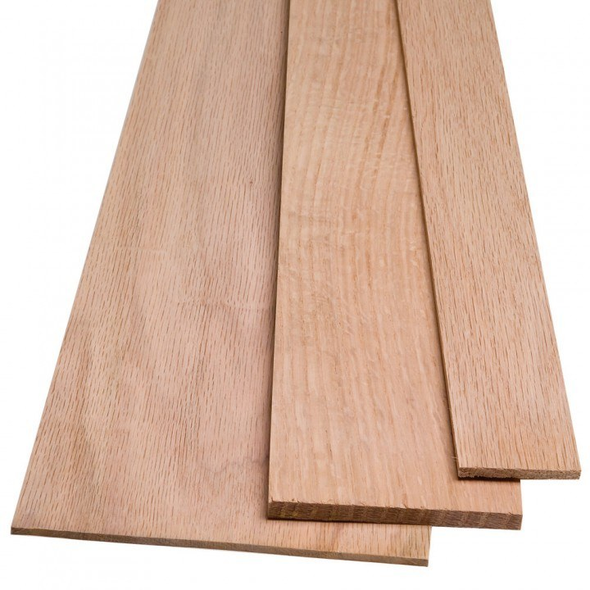
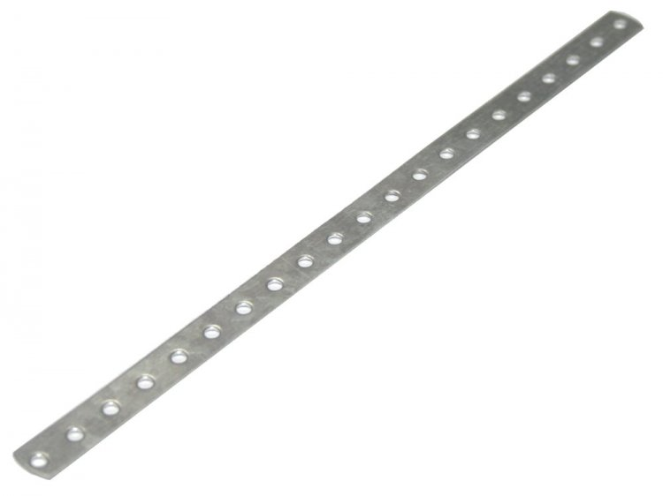
Casing Hardware
4 Sq. Ft. White Composite Board
Trim Head Stainless Steel Screws
Oak Wood Piece
Light Gauge Steel Strapping
¾ In. Black Screws (Wide Heads)

Slide 14




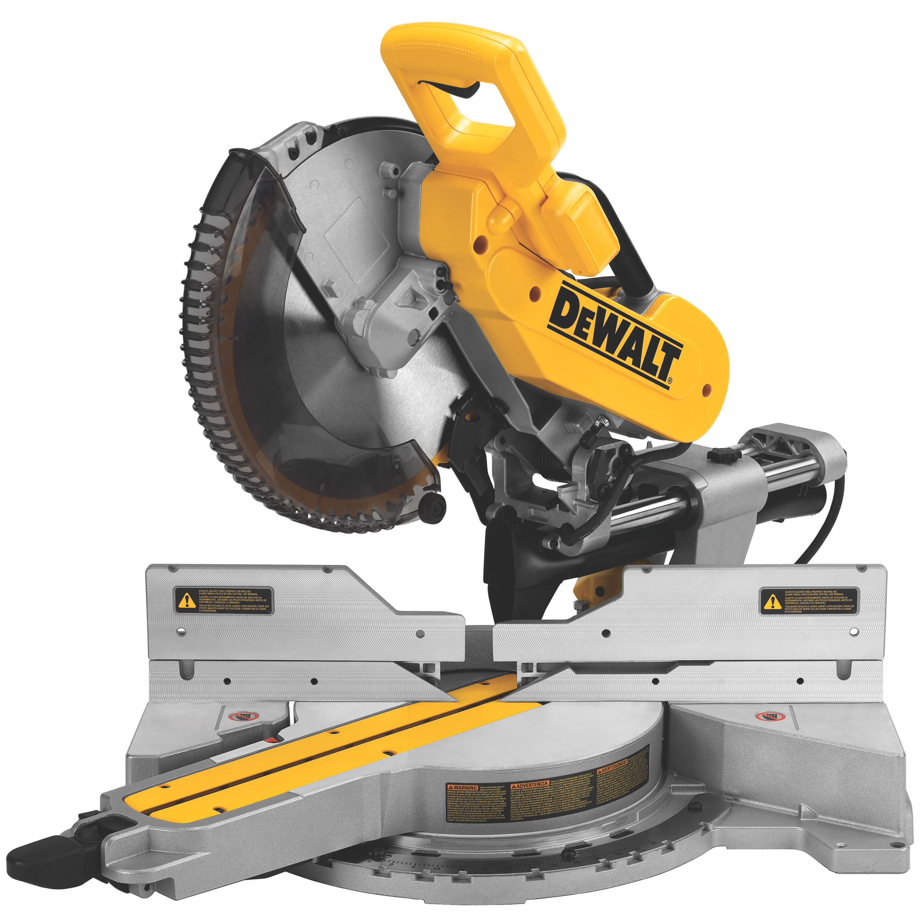

Hardware Tools
Small Screwdriver
Cordless Electric Drill
Square
Table Saw
Electric Router
Compound Mitre Saw
Jigsaw
Lineman Pliers
Material Clamps

Slide 15


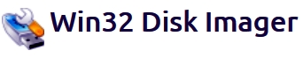


Software Tools
WinSCP
Apache Web Server
SD Formatter
Win32DiskImager
Adobe Dreamweaver CC 2015
Adobe Illustrator CC 2015

Slide 16
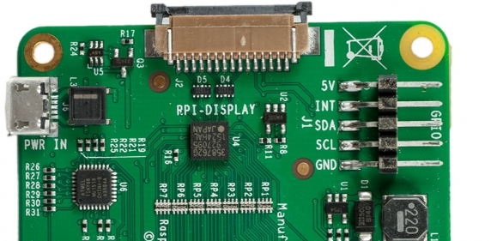
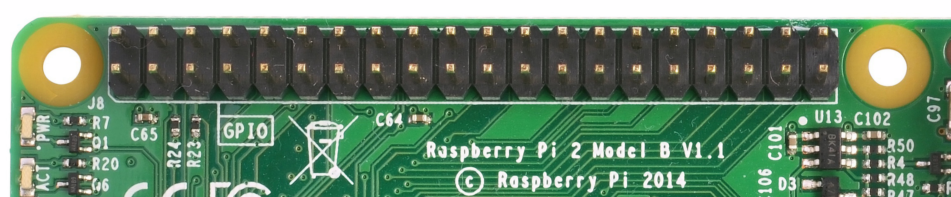
Process
Assembled Computer Hardware:
Attached Display Adapter Board to Touchscreen
Attached Raspberry Pi 2 to Display Adapter Board with Standoffs
Connected Ribbon Cable from Raspberry Pi 2 to Adapter Board
Connected Jumpers from adapter board to appropriate GPIO pins on the Raspberry Pi 2
-- 5V
-- GND
-- SDA
-- SCL

Slide 17
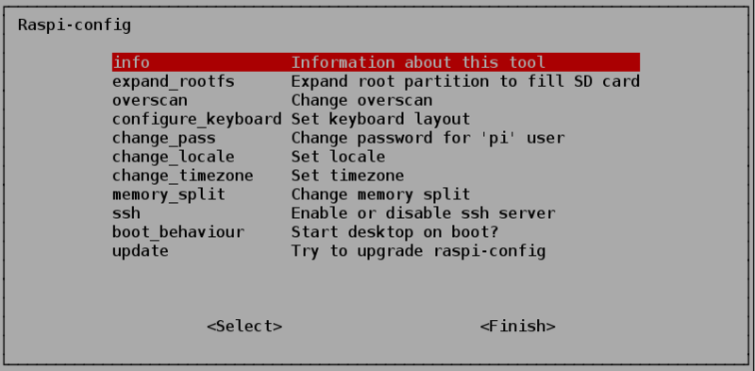
Process (Cont.)
Began Computer Function:
Installed Raspbian Wheezy Operating System onto MicroSD Card using Win32DiskImager
Booted up the Raspberry Pi and configured the OS (raspi-config)
Inserted USB WiFi Dongle and configured network settings
“sudo apt-get update && sudo apt-get upgrade”

Slide 18

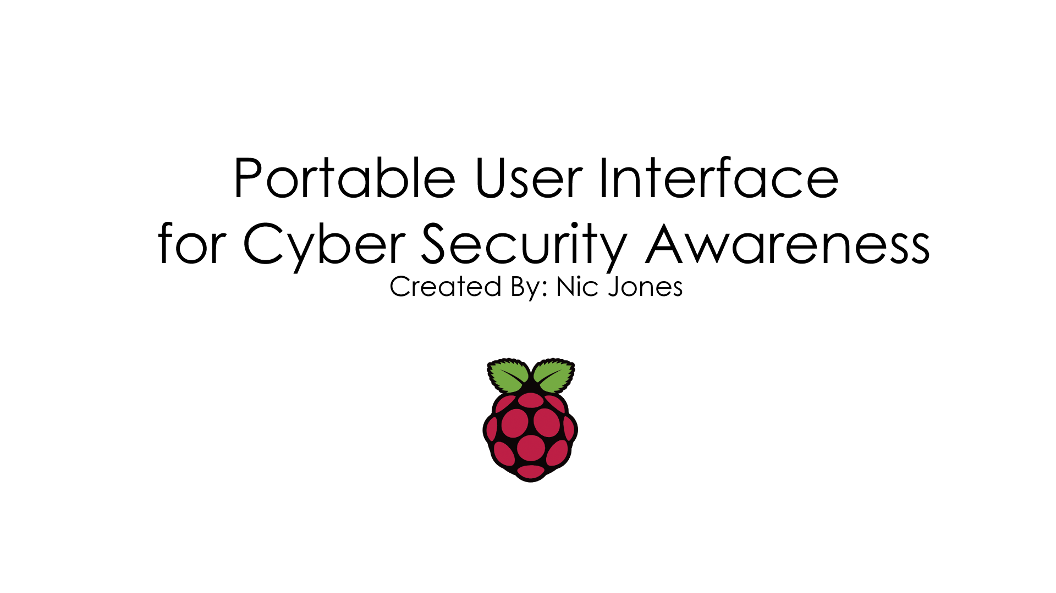
Process (Cont.)
Configured Kiosk Function:
“sudo apt-get install chromium unclutter”
Configured LXDE Startup File: “sudo nano /etc/xdg/lxsession/LXDE-pi/autostart” with
“@chromium --kiosk http://www.nicjones.org/stsp.html --incognito” as the last line
Disabled Auto-Sleep “sudo nano /etc/lightdm/lightdm.conf” with
“xserver-command=X -s 0 dpms” under the “[Seat Defaults]” Section
Configured Boot Image: “sudo apt-get install fbi” and put
My custom “Splash.png” made in Illustrator in “/etc/”

Slide 19
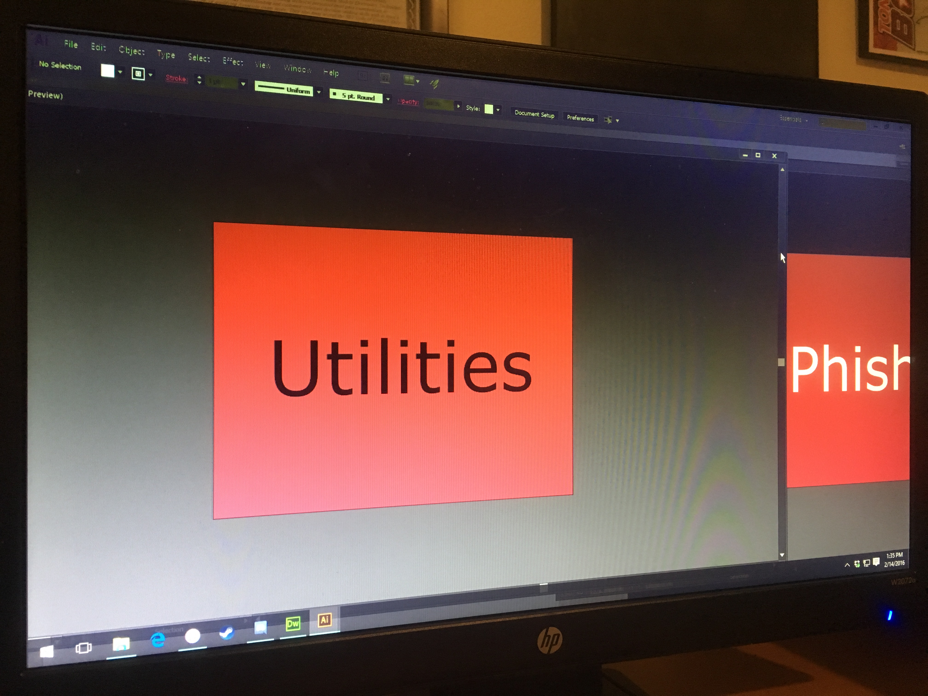
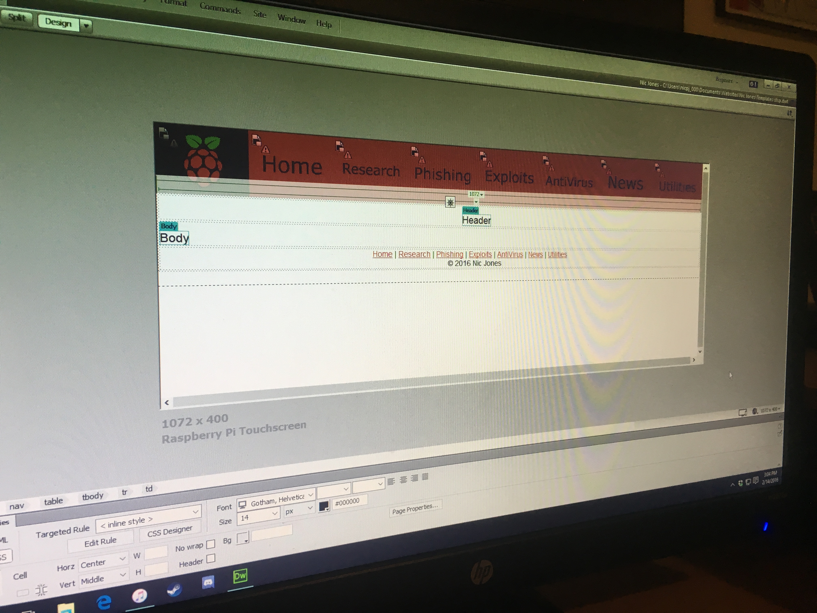
Process (Cont.)
Website Design:
Troubleshot Screen Resolution, Zoom, & Size for Chromium
Created logo, and banner buttons in Adobe Illustrator
Including: Home, Research, Phishing, Exploits, AntiVirus, News, & Utilities
Fabricated the Website Template in Adobe Dreamweaver

Slide 20
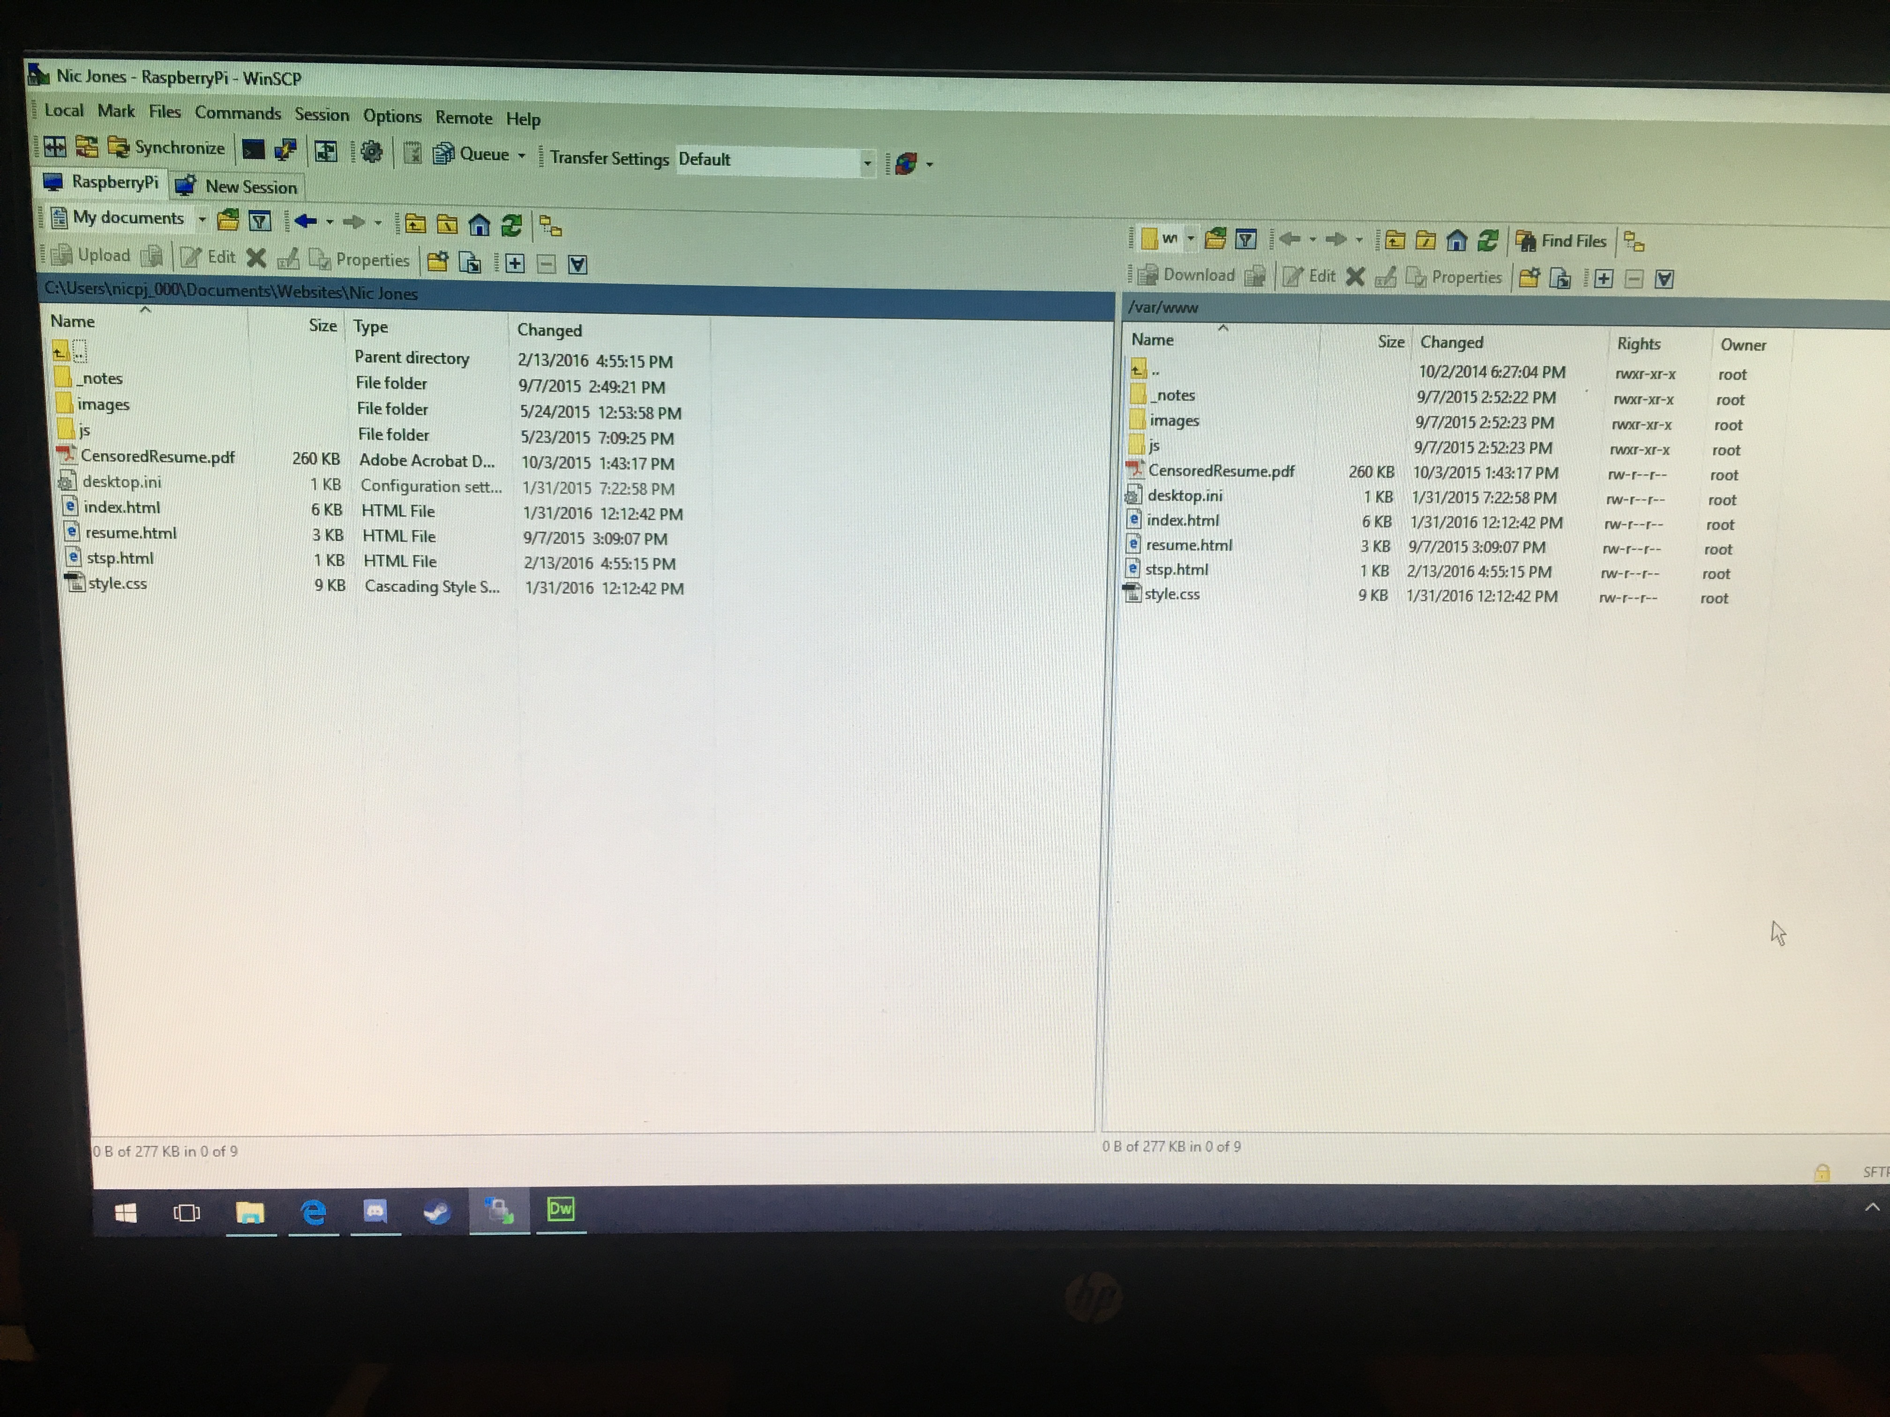
Process (Cont.)
Testing the Website on the Webserver:
Another Raspberry Pi Model B Running Apache Web Server at home
Has SSH Enabled
Using WinSCP on my Windows PC I connected via SFTP to my other Raspberry Pi
Sychronized website directory on my Windows PC to Raspberry Pi “/www/” directory
Already had a webserver running before so port-forwarding to the domain with GoDaddy.com was already set up

Slide 21

Process (cont.)
Website Design (cont.):
Template complete with all banner links and rollover buttons working
Time to create the web pages and fill them in with content
RSS feed script was used
Some pages use the “<iframe>” HTML tag to contain other websites within my own
Used the “sandbox” attribute with “<iframe>” so that the user could not go to an external site

Slide 22
Process (cont.)
Website Design (cont.):
The Home page
The Research page
The Phishing page
The Exploits page
The AntiVirus page
The News page
The Utilities page

Slide 23
Process (cont.)
Website Completion:
At this point the website was complete
All hyperlinks working as they need to
But WHAT would I do if there was no WiFi?
I created a separate special Offline version of the Website
Hosted it on a local server on the device using lighttpd
Created a button under the “Utilities” tab to resort to the offline version
Configured the Raspberry Pi to boot up into the offline version first

Slide 24
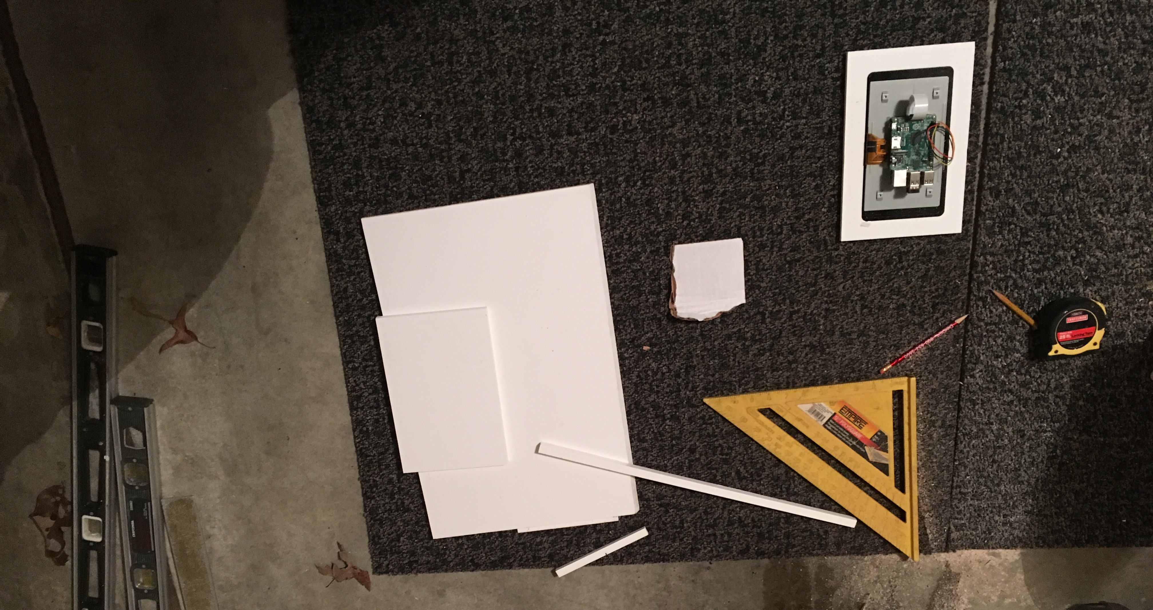
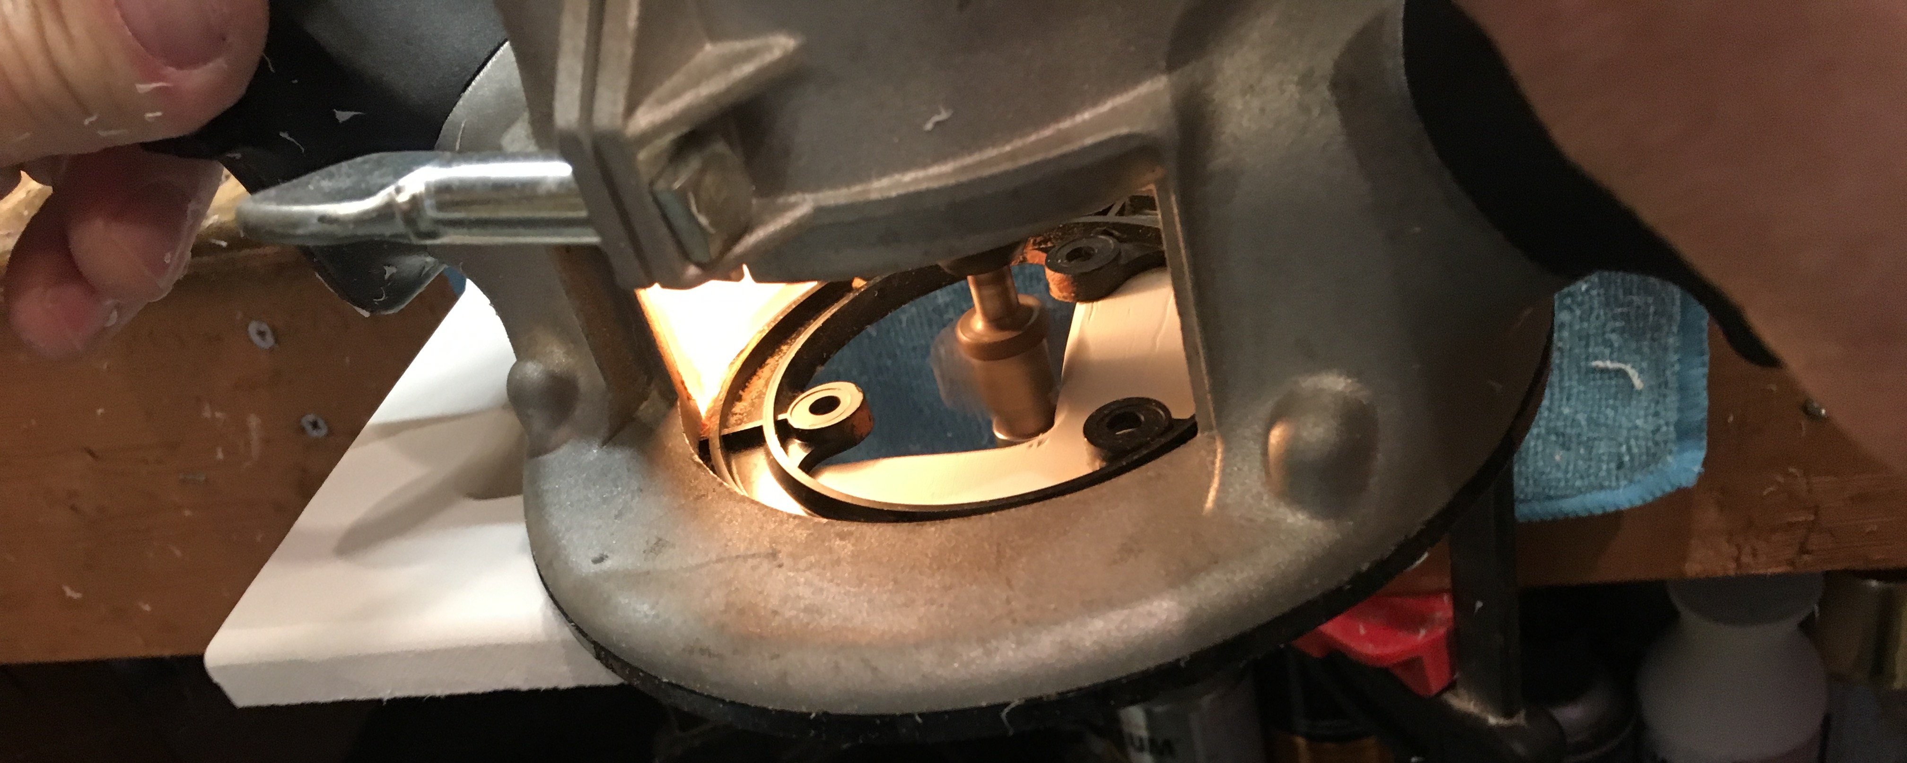
Process (cont.)
Now for the Casing:
Decided on using Composite Board as the main material
First measured and cut the face frame for the screen
Routed the edges of the frame to give it a cleaner look

Slide 25
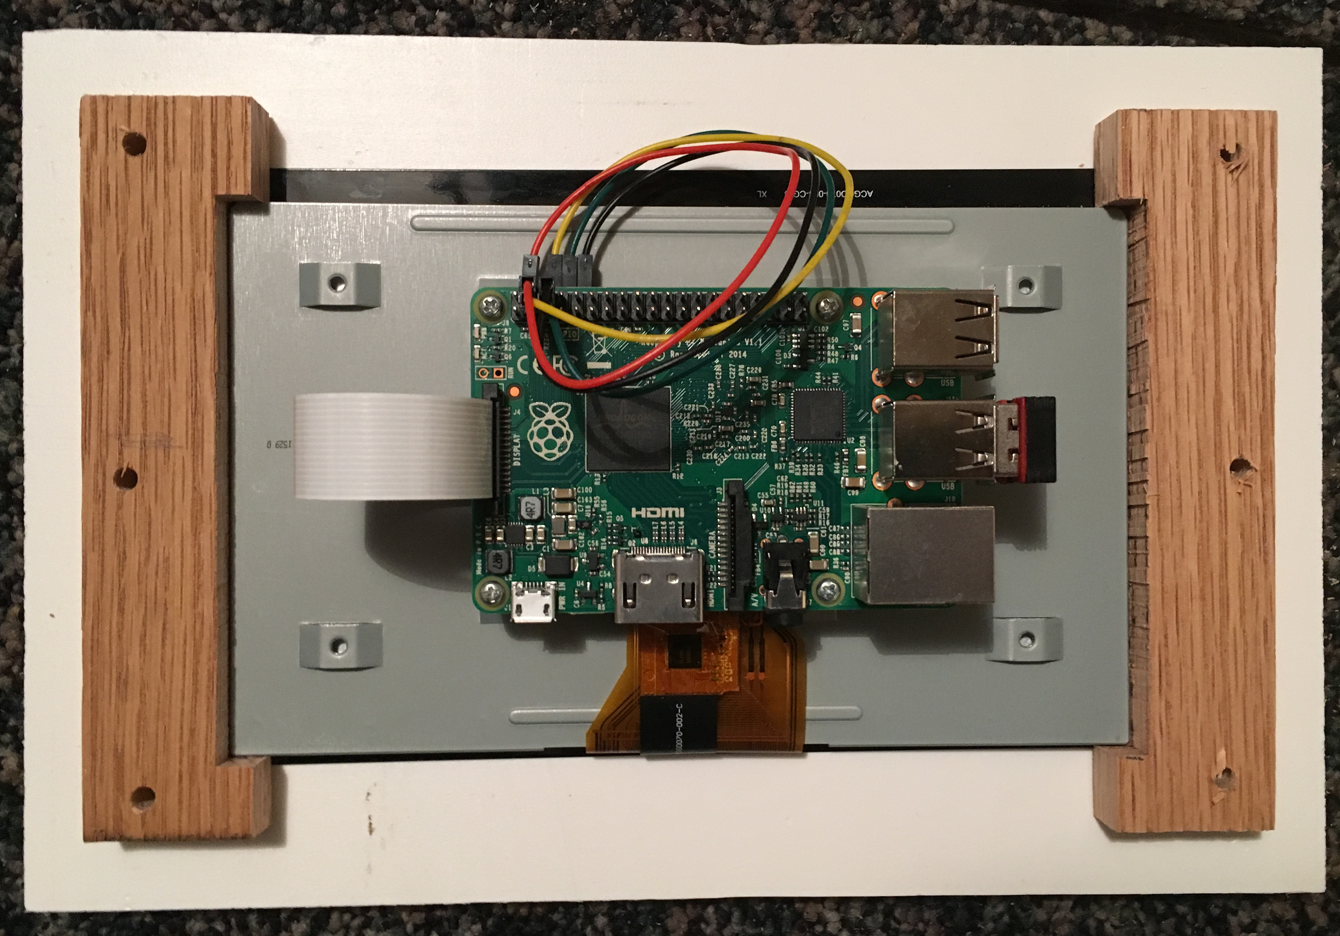
Process (Cont.)
Mounting the Screen to the Frame:
Used a jigsaw to cut out the inside square of the frame
Wanted a discrete and non-damaging mount to the screen
Used a strong piece of Oak wood to pinch the very edges of the screen to the frame
Used wide headed screws to fasten the Oak to the frame, securing the screen
Cut the tips of the screws using Lineman’s Pliers so they did not stick through the front

Slide 26
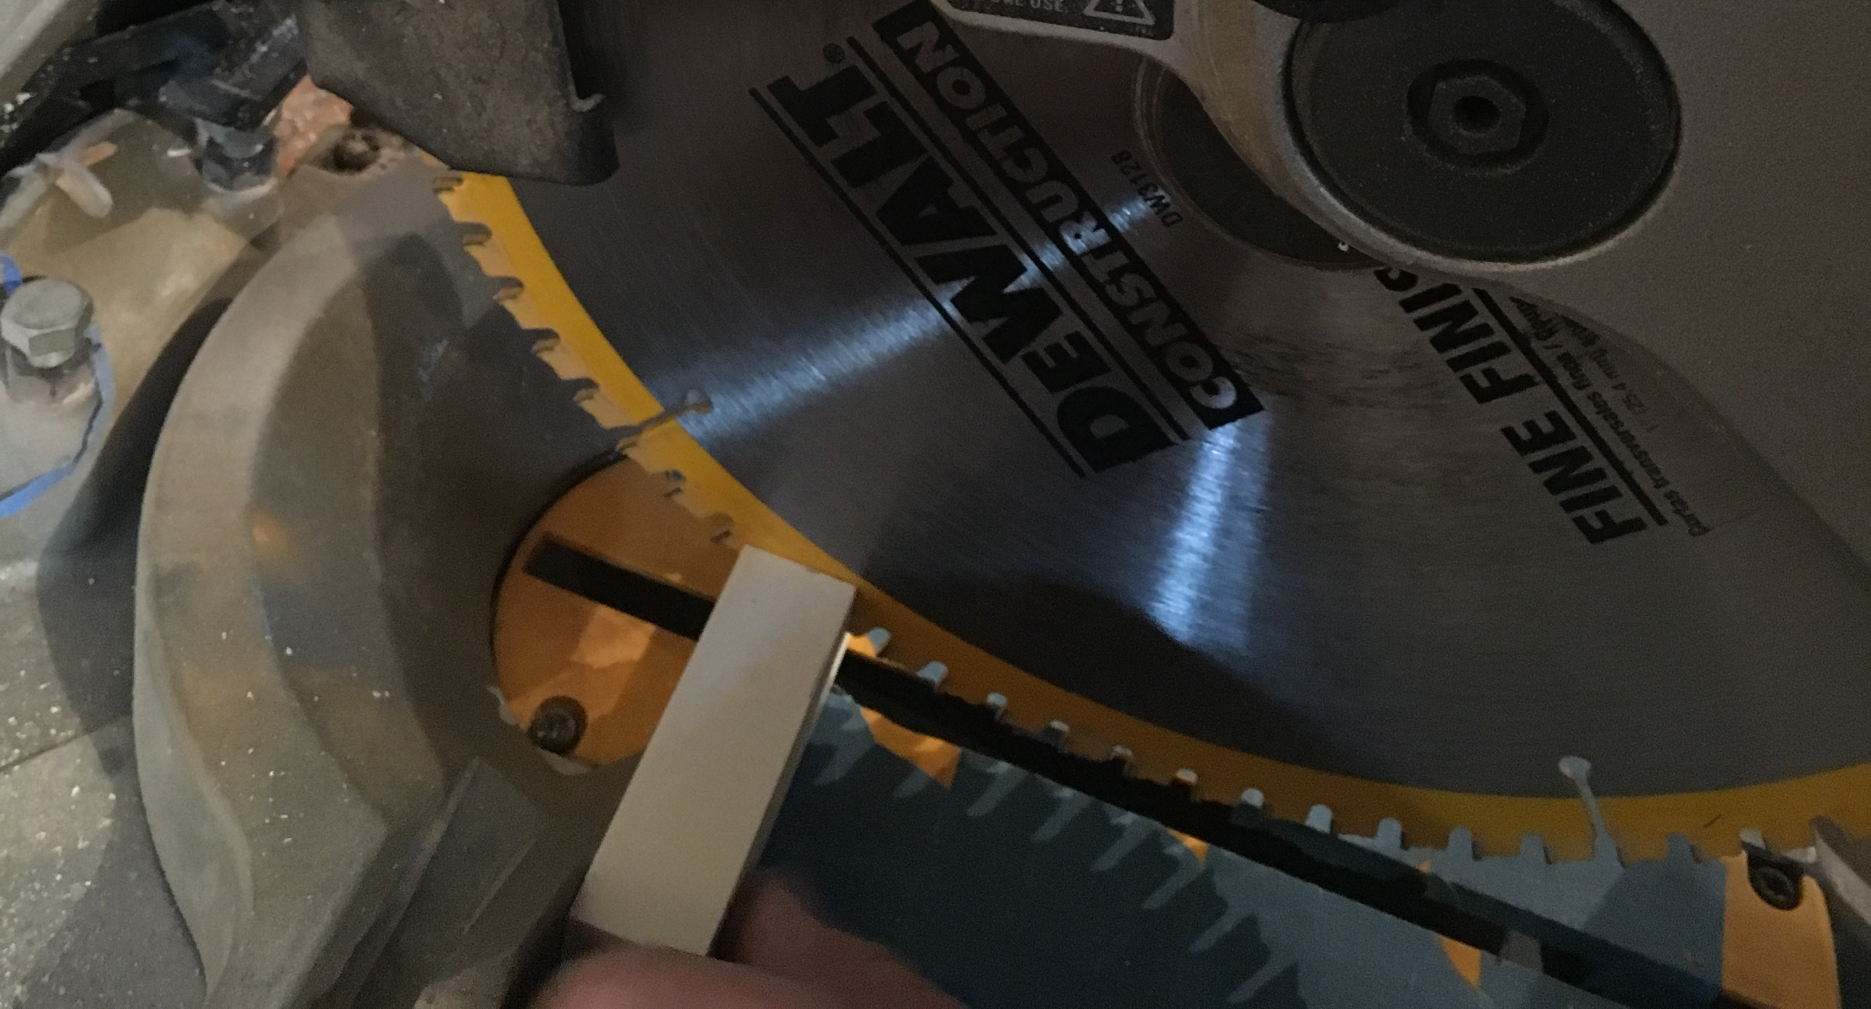
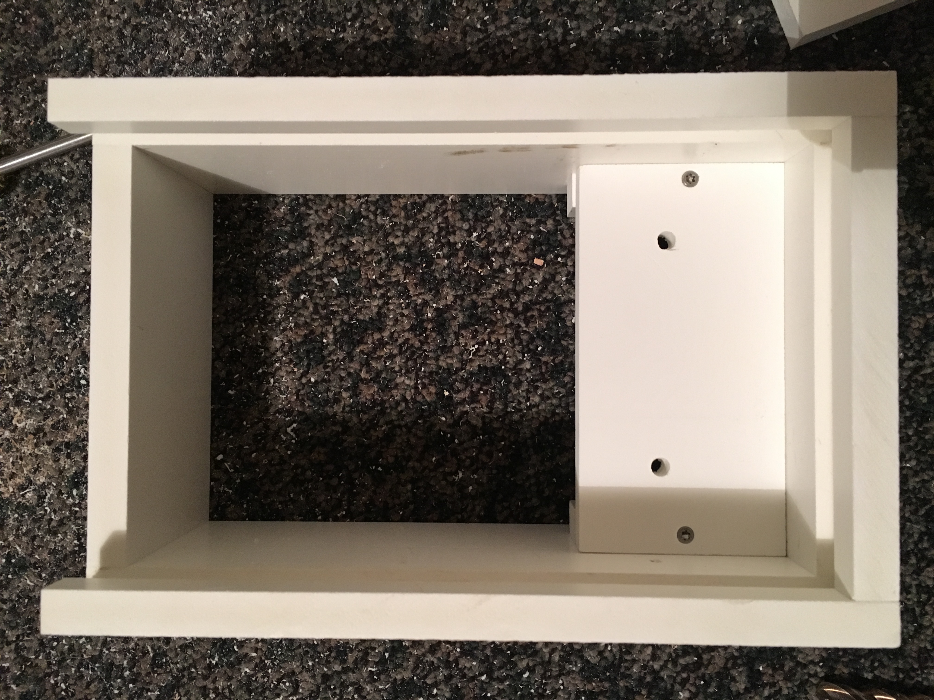
Process (Cont.)
Creating the Structure:
Time to create the main body of the casing
Cut the measured pieces of composite using the Compound Mitre Saw & Table Saw
Created a shelf for the battery on the inside without interfering with the Raspberry Pi
Secured composite pieces with Trim Head Stainless Steel Screws

Slide 27
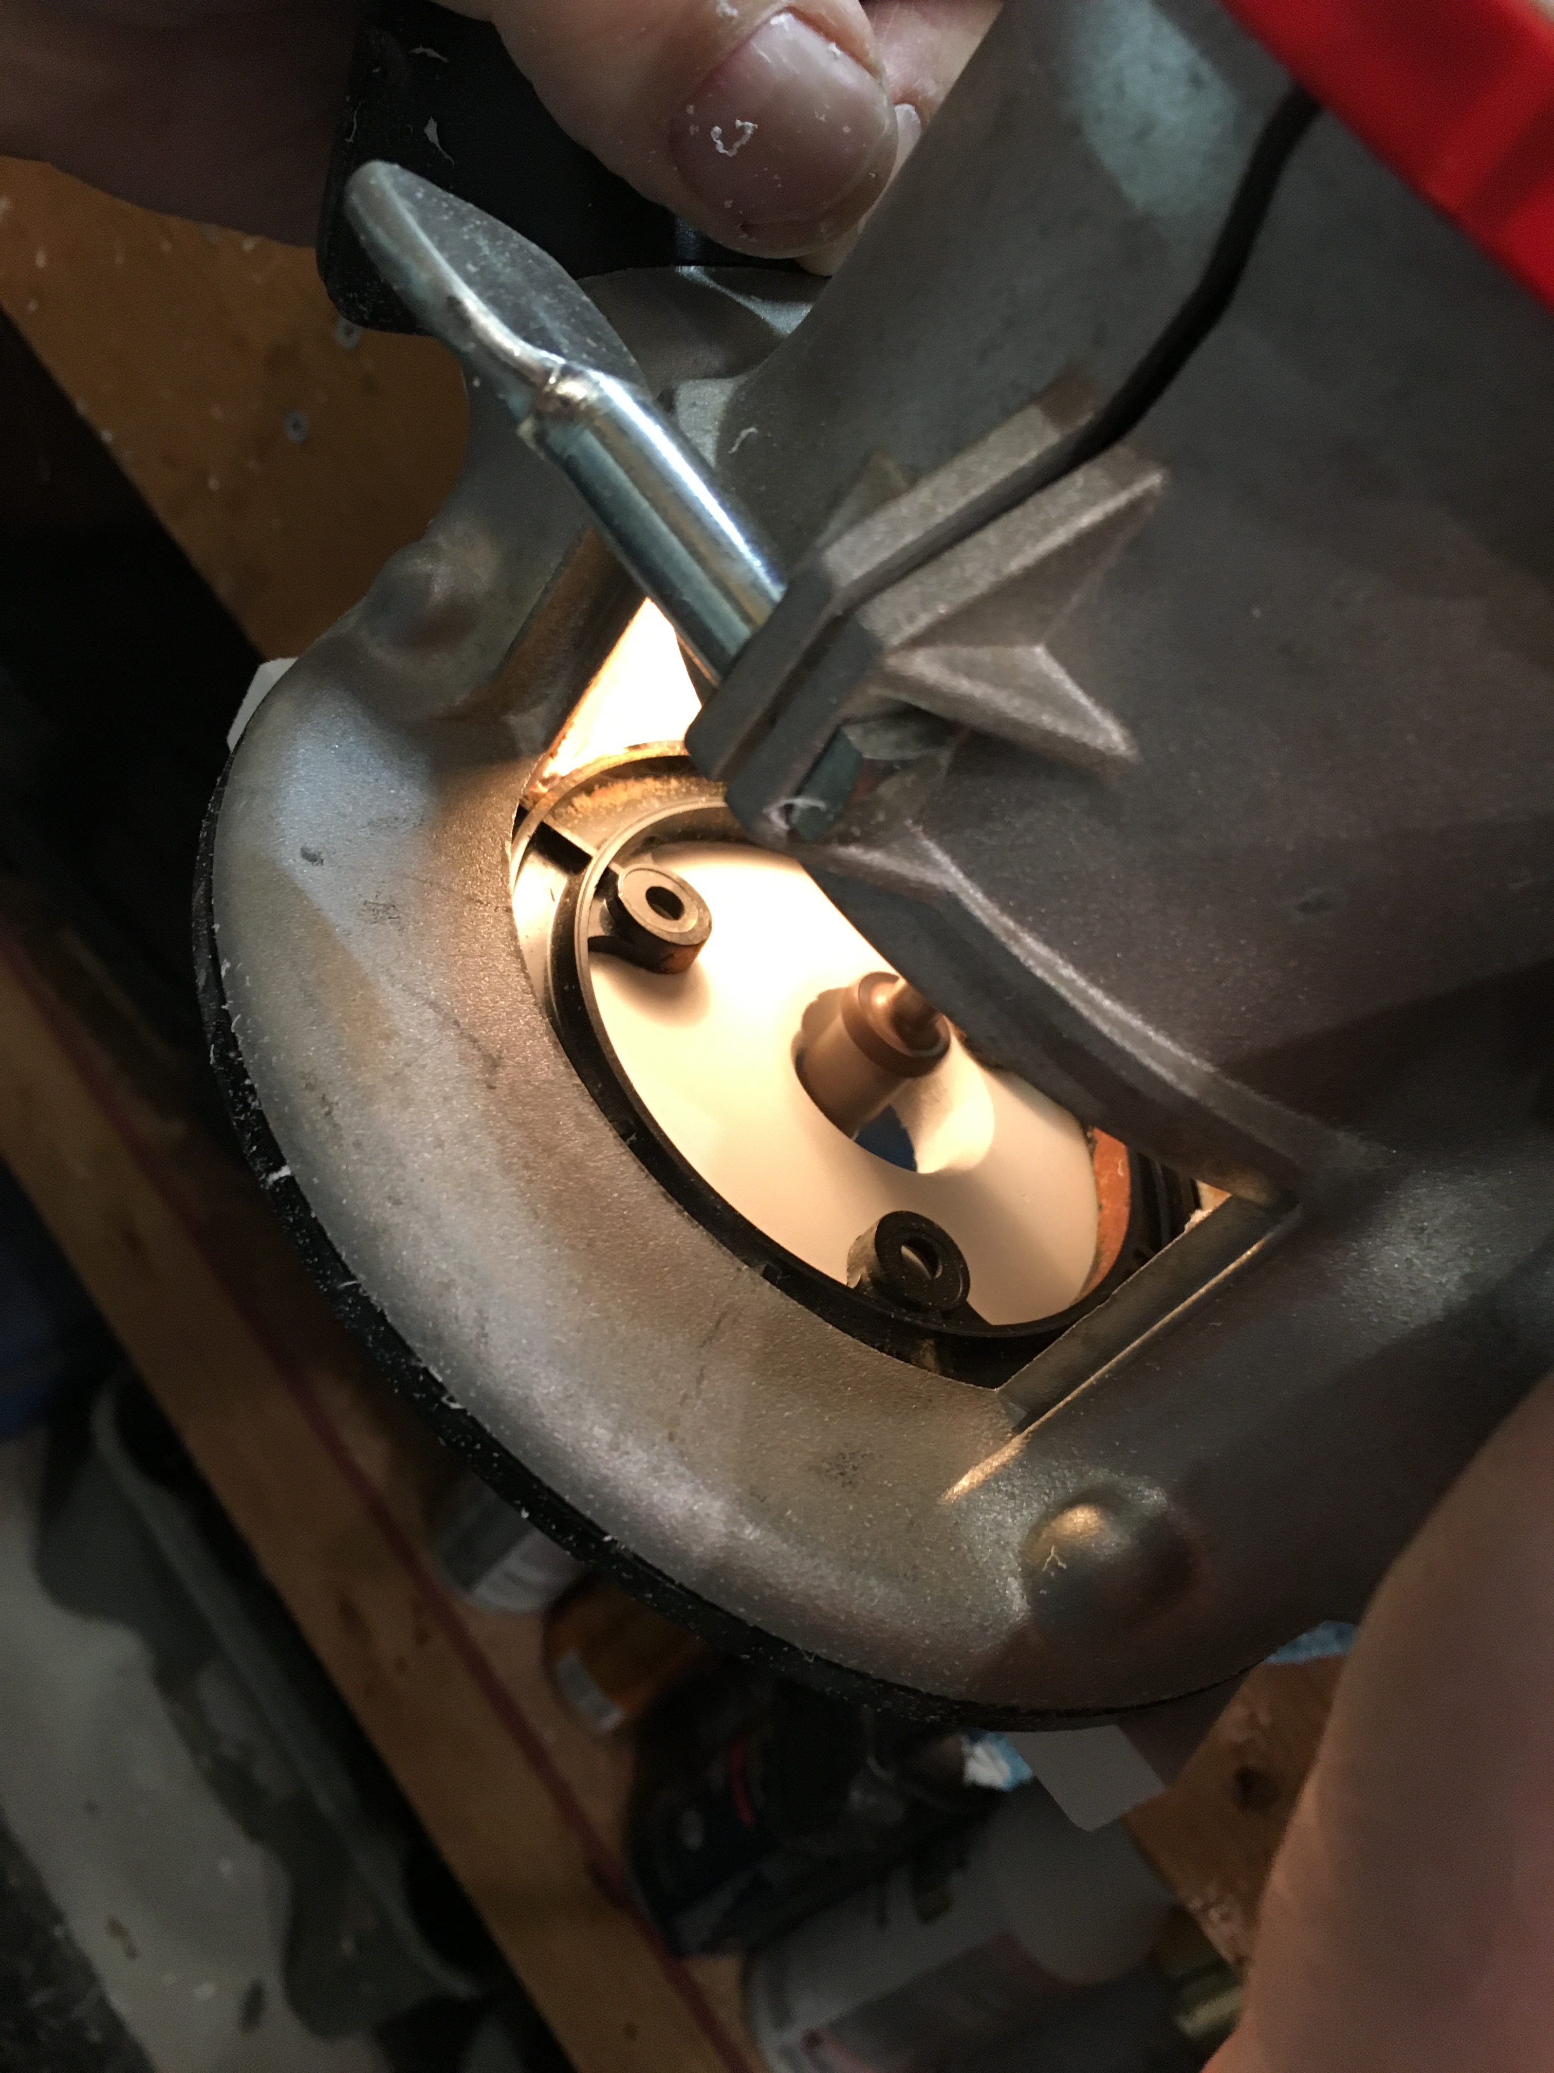
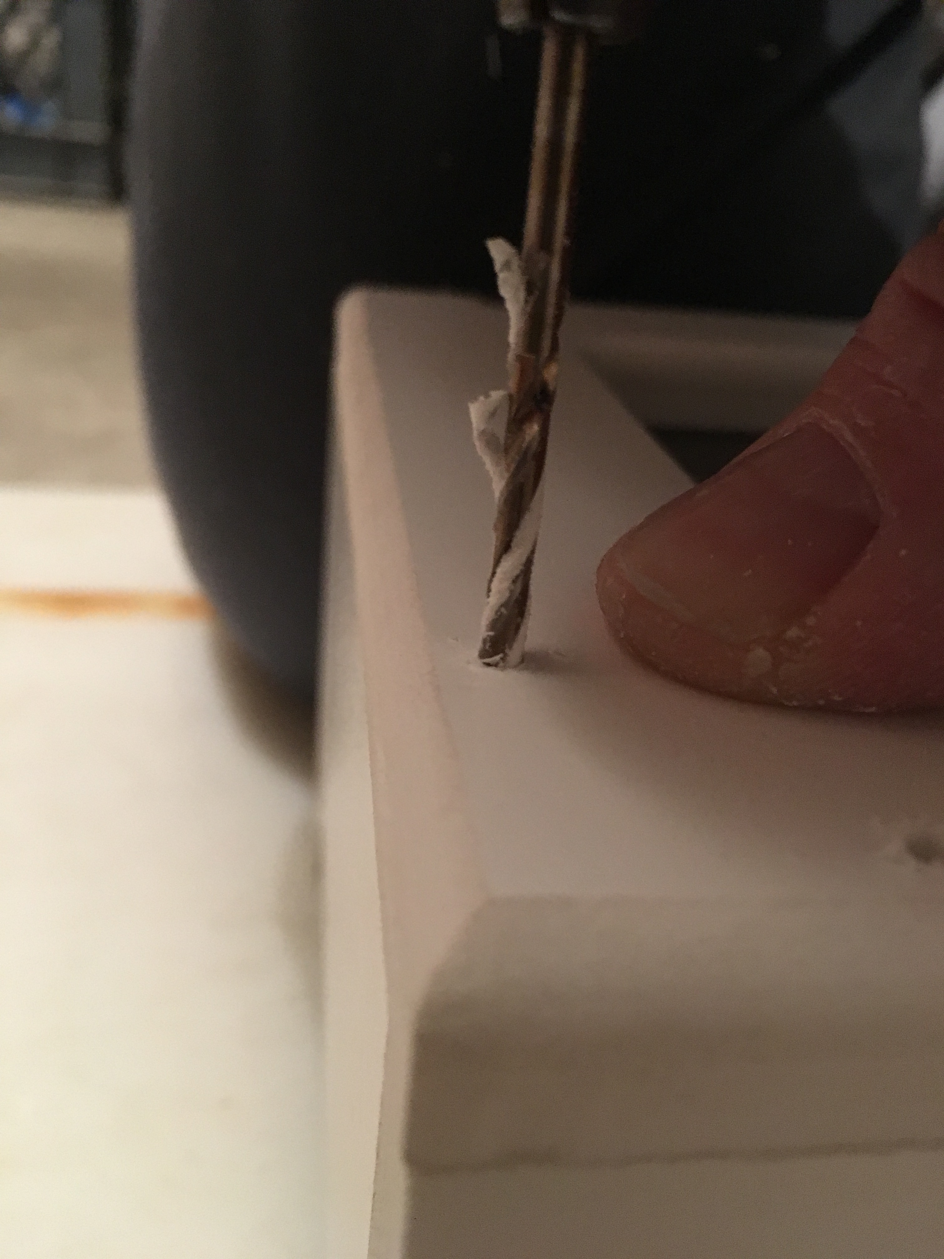
Process (cont.)
Finished off the Casing:
Slotted the edges of the casing with the table saw to have a sliding back to close
Attached the frame and hardware to the casing with precision using Trim Head Stainless Steel Screws
Cut out a tightly fitting piece of composite to slide in and close the back
Created a routed hole in the sliding piece for ease of access

Slide 28
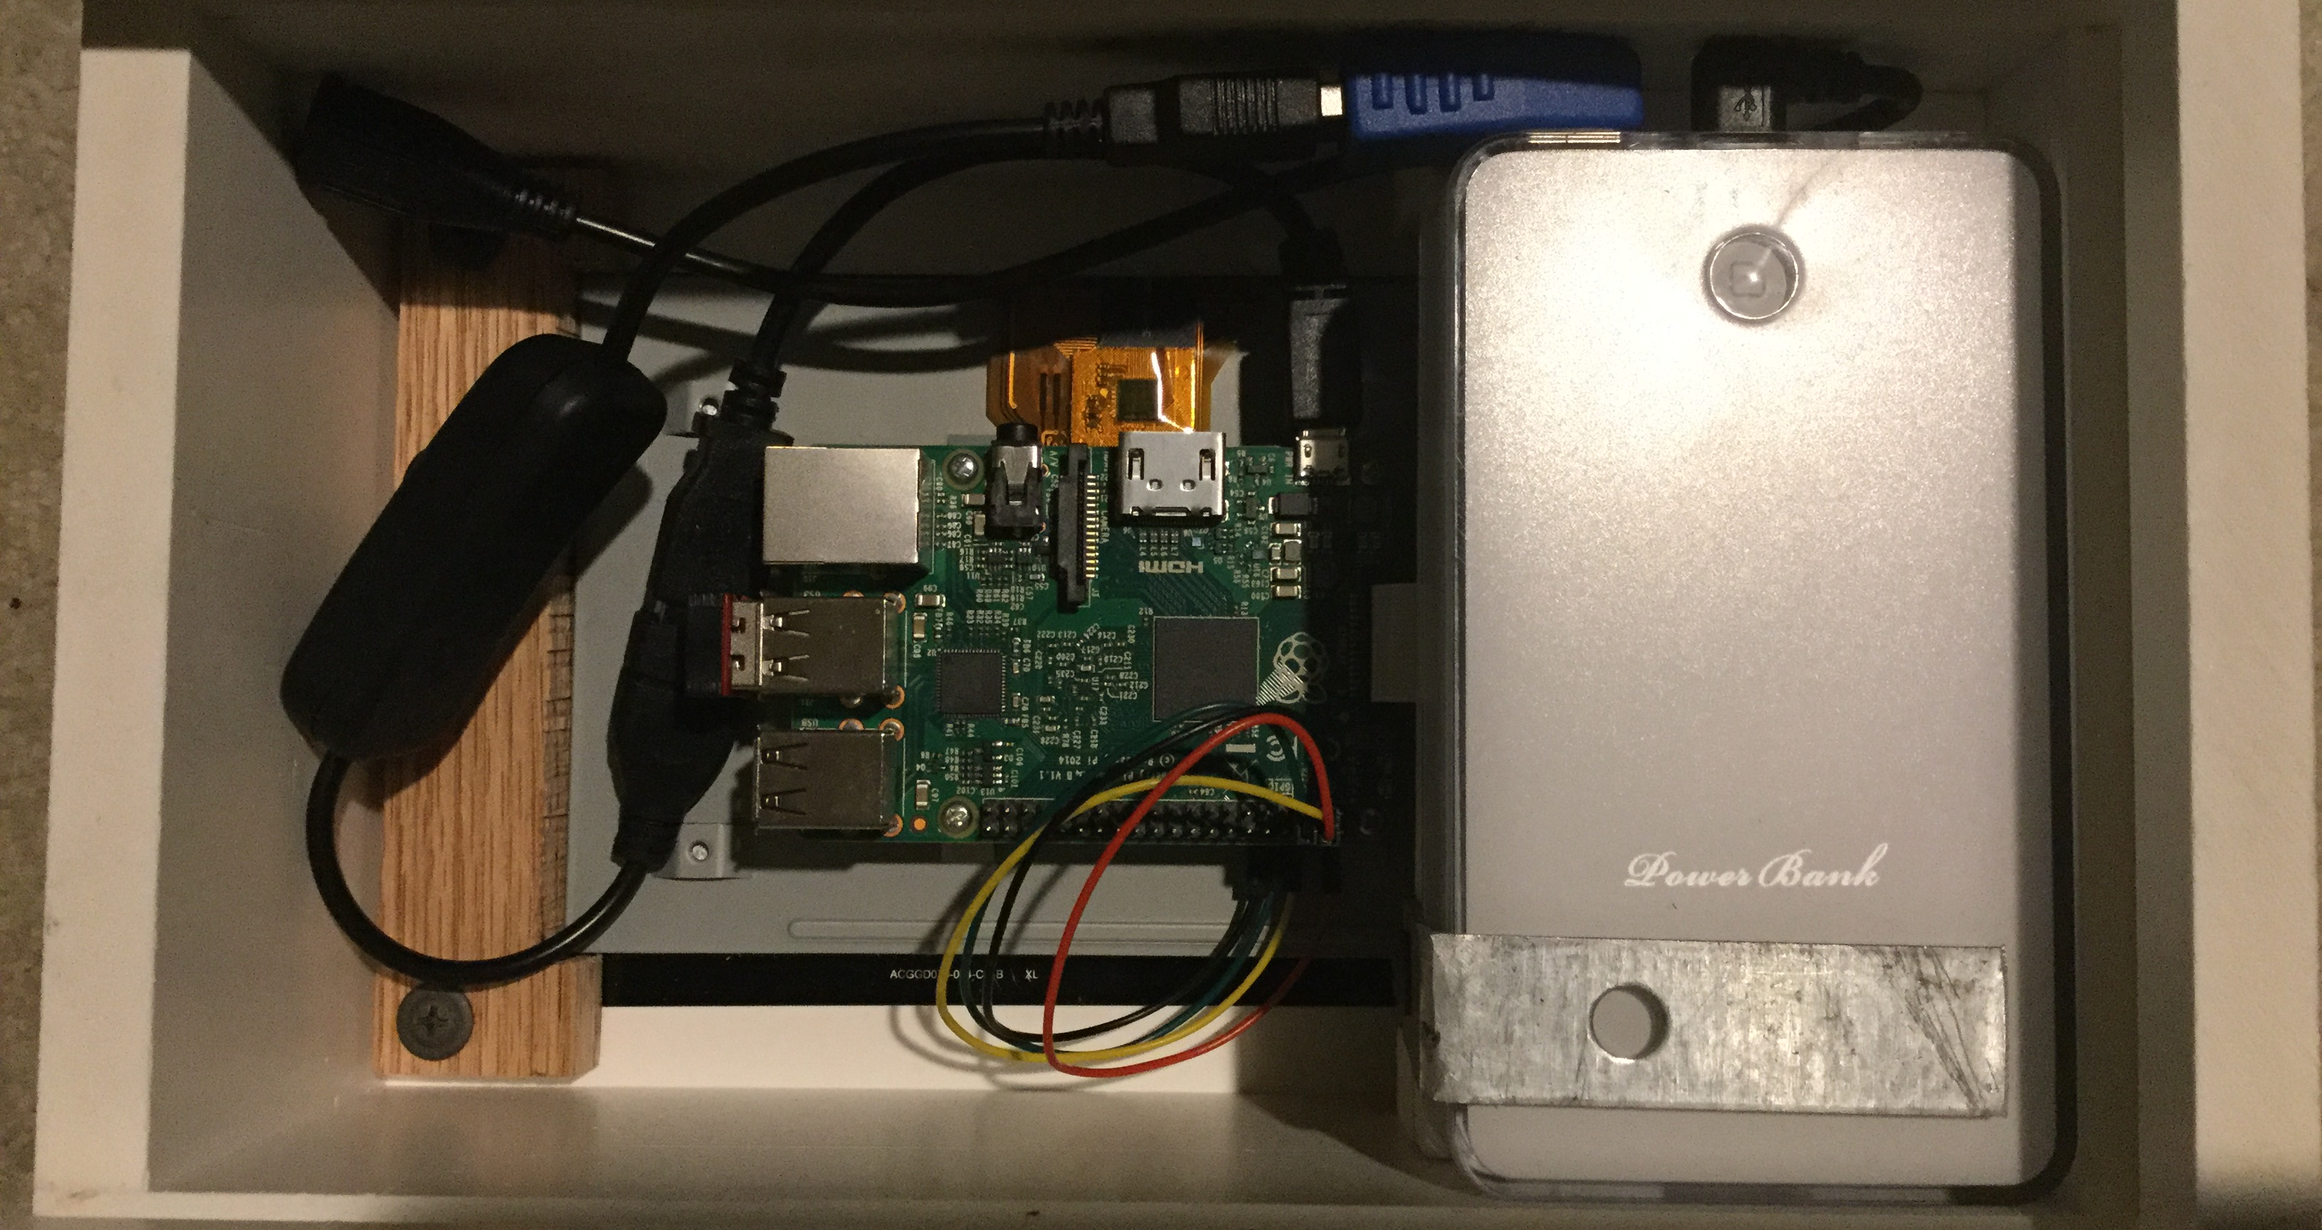
Process (cont.)
Connecting Battery and Power:
Secured the battery to the case with an angled piece of Light Gauge Steel Strapping
Used an angled USB Type A Female connector to connect power to the Raspberry Pi via a USB Micro type with a USB from the 2A supply port on the battery
Included a USB Type A switch in series for easier on/off function
Have a female USB type B Micro for charging the battery inside

Slide 29
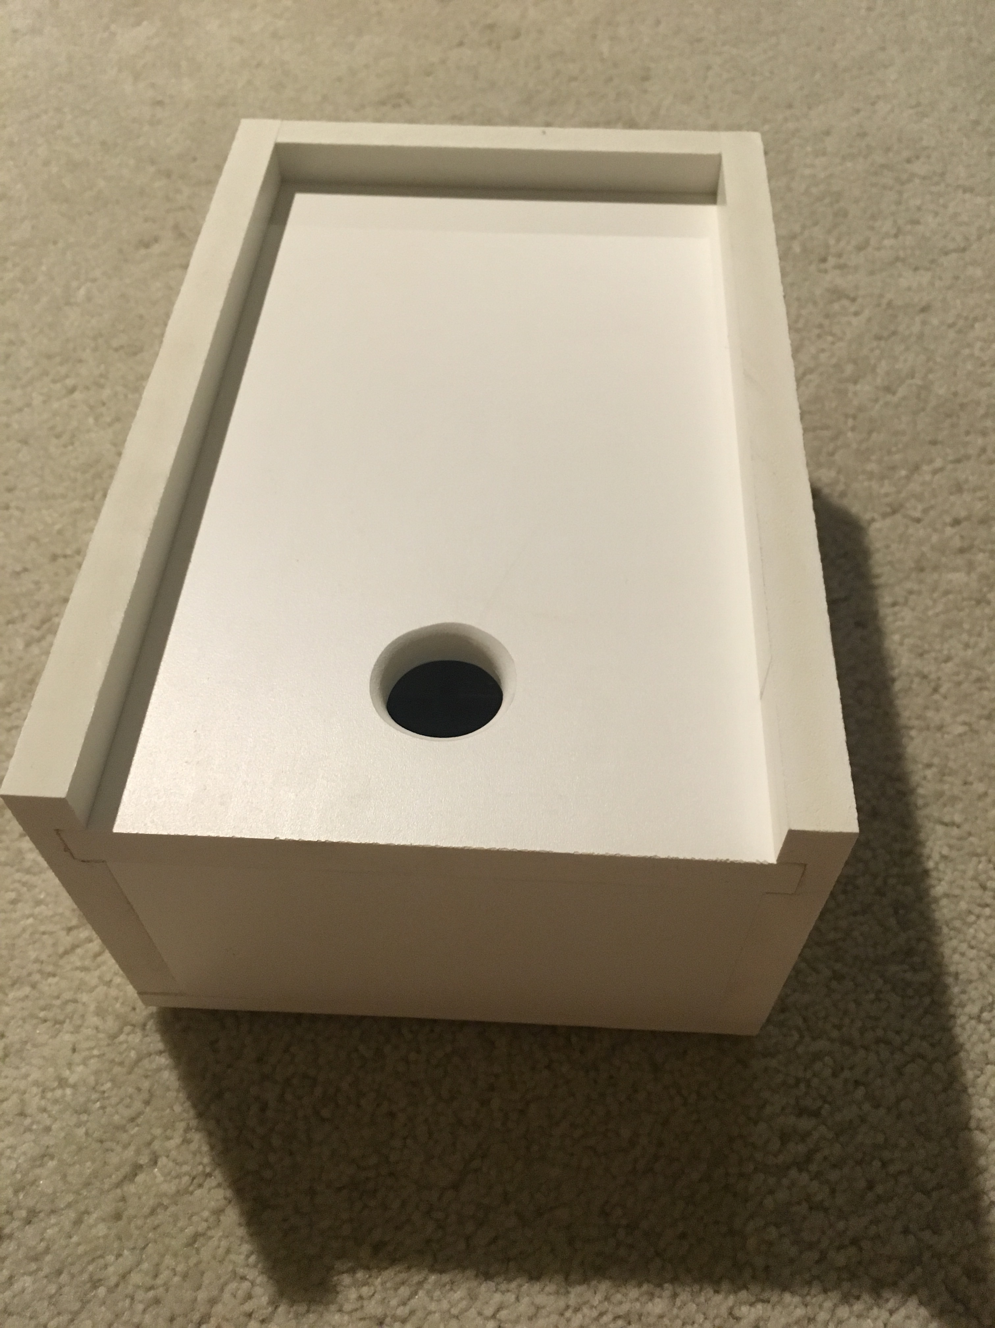
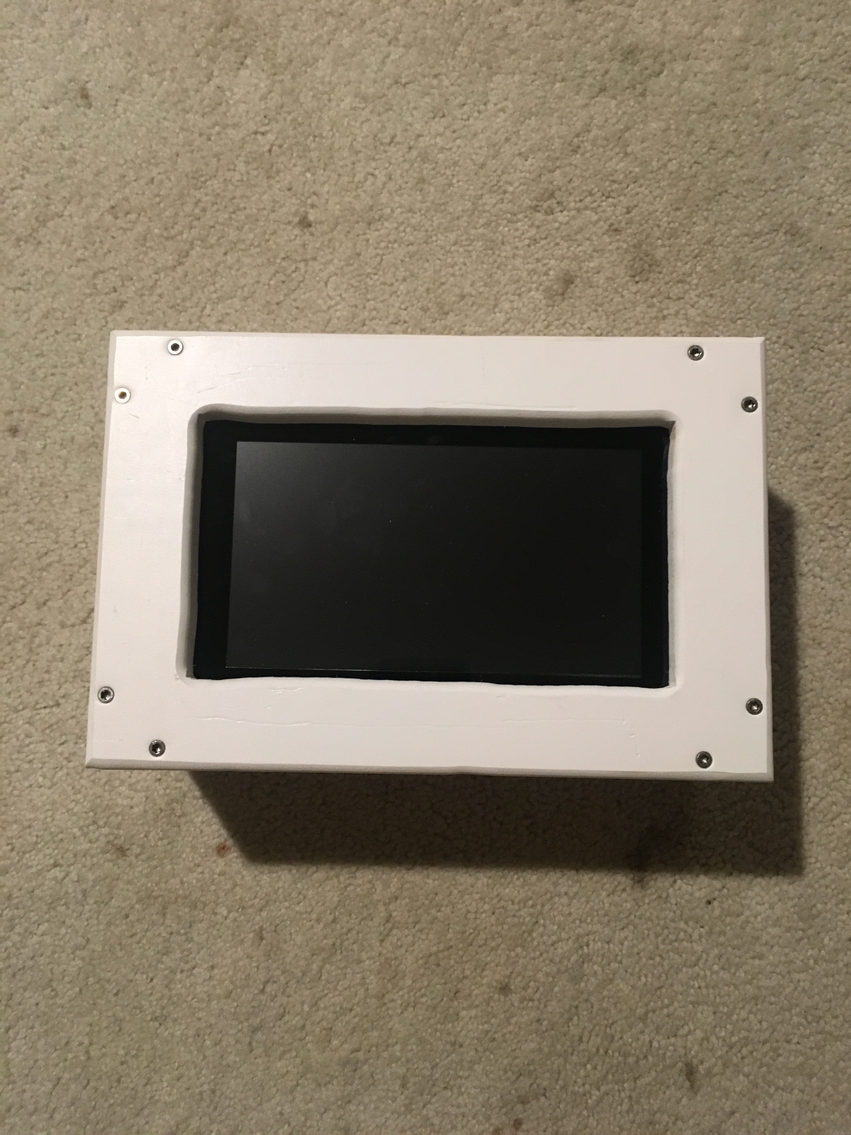
The final Product
The final product is overall very clean and functional
Best feeling to start it up in the finished case
Tested it within range of WiFi and within range of WiFi
Although it isn’t perfect, it is unique and something that I built

Slide 30
What changed?
What changed along the way that was not part of my original planning?
Originally considered Plexiglass for the casing but instead used Composite
Wanted to have an outer installed power switch but put it on the inside
Intended on it being thinner

Slide 31
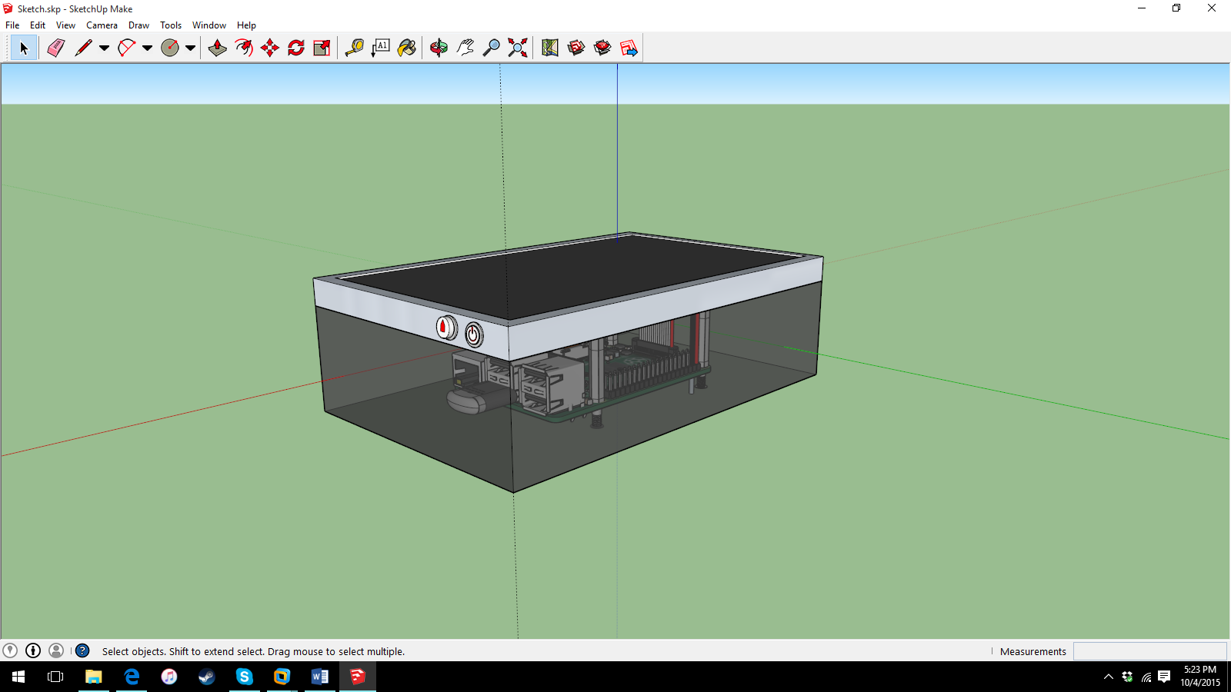
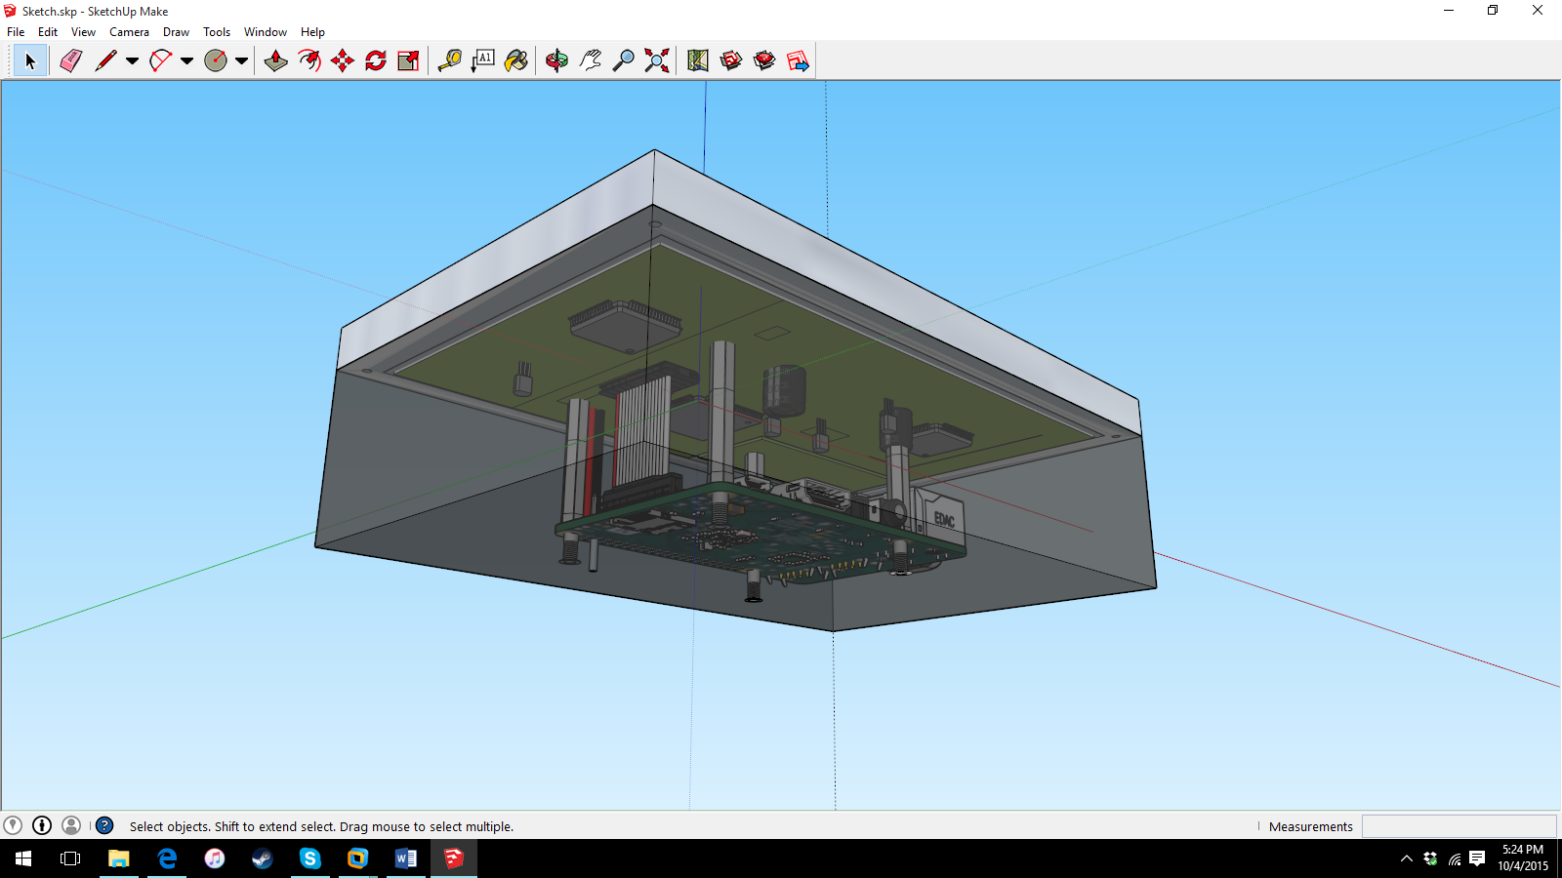
What Changed? (cont.)

Slide 32
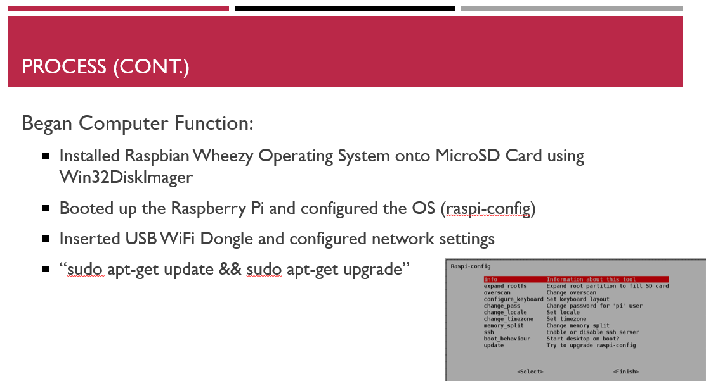
Problems
What problems did I have along the way?
Took a long time to get the screen resolution of the website to perfectly fit the screen
Had to reinstall the operating system and resources MULTIPLE times

Slide 33
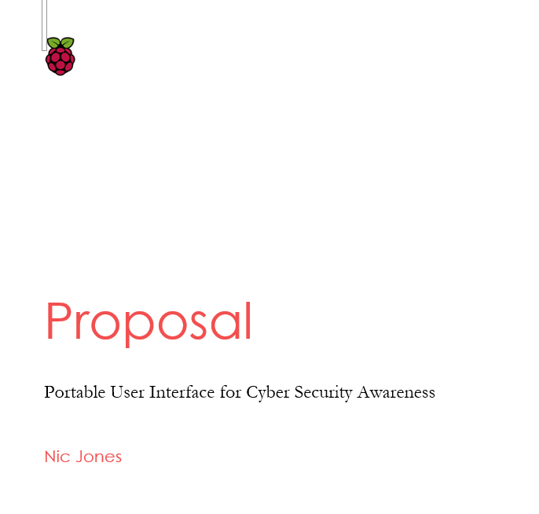
What did I learn?
Troubleshooting and Testing of Websites
Considering the User
Planning ahead

Slide 34
Back to the problem
The people involved in using systems for what they’re made to do, need to be more educated on how to protect themselves on them
They need a general platform for understanding how to protect themselves on the most basic level needed against cyber attacks
If the weakest link can be fixed, cyber security can be greatly improved

Slide 35
Where My project comes in
My hope is not that my project is what people use in order to be more educated about cyber security
My project is just a start
My project can serve as an example to start an initiative for more professional cyber education platforms to be developed

Slide 36
Thank You
Any Questions?

